Slide 1
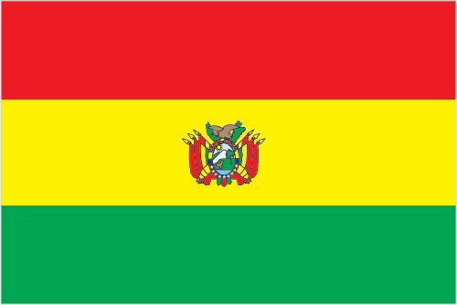
Bolivia
By: Taylor Drake
7th period
3/19/2014

Slide 2
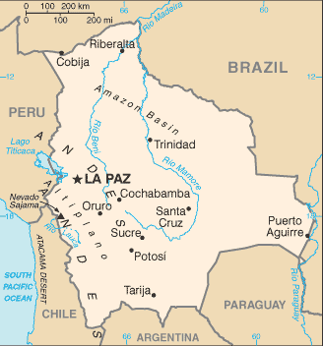
introduction:
The capital of Bolivia is La Paz
Bolivia is located in South America
Major languages spoken in this country: Spanish, Quechua, and Aymara
Map of Bolivia

Slide 3
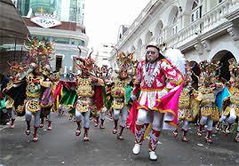
Culture
Bolivia’s culture consists of holidays the celebrate rituals and tradition of pagan (ritual).Also, the celebrate Independence Day on August 6th. They drink lots of wine and eat various foods such as corn and wheat foods like pasta and rice. They have a Democratic government and developed a constitution. The main religions practiced are Roman Catholic and Protestant. People dress depending on what region they live on. They tend to wear lots of hats or long clothing. Also, they wear lots of color.
Independence Day festival

Slide 4
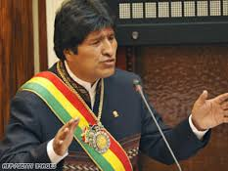
History:
Evo Morales President of Bolivia.
Bolivia was once part of the Inca Empire and had lots of mineral wealth. Then it started to fade and the country began to fall. Simon Bolivar broke Bolivia from Spanish rule in 1825. Bolivia consisted of 200 ethnic groups in the 1900’s. Past Presidents had attempted to reform the government and get more jobs for the people, but no one was as effective as Evo Morales. The people elected Evo Morales as President to restore the country. There wasn’t a surprise when Morales won at reelection and took over the Legislative Branch leading the country to change for the better.

Slide 5
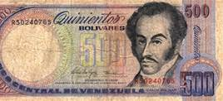
Economy
Bolivia produces products such as: soybeans, coffee, cocoa, cotton, corn, sugarcane, rice, potatoes; Brazil nuts; timber they have big mining and petroleum industries. Also, they have a large agricultural industry.
The currency is the Bolivian boliviano.
Bolivian boliviano

Slide 6
climate
The weather patterns create large variation depending on where you are, but overall Bolivia has a dry and rainy season. Some areas tend to have more extreme effects of these climates. The rainfall affects the agricultural industries positively and helps bring in higher incomes during those seasons.

Slide 7
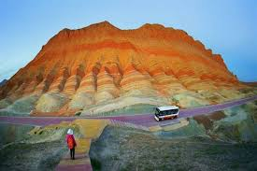
Geography
Bolivia is about the size of Texas and includes lots of land features. The Andes run through and along with some dormant volcanoes. The Cordillera Central is a mountain that stands in the middle. The La Paz is an area where rivers drain into from narrow deep valleys. Santa Cruz is a major city apart of the nine states that thrives with business of tourism.
Rainbow
Mountains

Slide 8
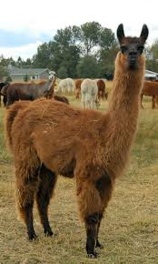
Interesting Facts
Bolivia’s population makes up 10.5million
Bolivia has the largest deposit of lithium.
Bolivia has the highest navigable lake in the world
its national symbol is the llama
Bolivia has 21 airports
Llama

Slide 9
Conclusion
Thank you for going on this journey to learn about Bolivia. It is a great country of culture and has wonderful physical features located there!

Slide 10
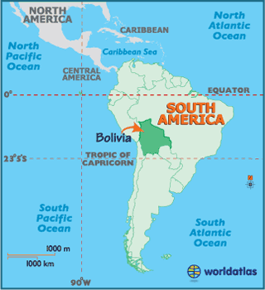
QUESTIONS:
What do Bolivians drink a lot of?
How many airports does Bolivia have?
Which State is about the size of Bolivia?

Slide 11
Bibliography:
https://www.cia.gov/library/publications/the-world-factbook/geos/bl.html
http://www.boliviabella.com/climate.htm
http://www.bolivia.com/

