Slide 1
Dominica
By: Sarah Burns 3/19/14

Slide 2
Introduction
Name: Dominica
Capital: Roseau
Major languages: English and French patois
Location: Caribbean- between Caribbean Sea and North Atlantic Ocean

Slide 3
History
Date of Existence: 1884
Dominica was explored by Columbus in 1493, and claimed by France and Britain until 1763.
Patrick John was the first prime minister.
Prime minister: Hon Roosevelt Skerrit
Late Prime Minister: Pierre Charles

Slide 4
Major Events
In 1627, the British took possession without settling, but by 1632 it had become a French colony
It remained a French colony until 1759 when the British took over
In 1660 the British and French agreed not to disturb the Caribs, but French settlers kept arriving with African slaves
The French tried to invade for 10 years before withdrawing and leaving the British in control.

Slide 5
Independence
Gained independence on November 3rd, 1978.
The DLP (Dominica Labour Party) created local demand for greater autonomy in internal affairs. Edward LeBlanc became chief minister in 1961
In 1967, Dominica became one of the West Indies Associate States with full self government control , but the UK remained in control of foreign policy and defense.

Slide 6
Independence cont.
LeBlanc retired in 1974
Patrick John then became DLP leader and premier. John worked with the Associate States top become independent separately.
In 1978, Dominica gained independence.

Slide 7
Geography
Dominica is an island in the Caribbean located between Martinique and Guadeloupe.
It is called the Nature Island because two- thirds of the island are covered in dense rainforest. It contains numerous lakes, rivers, waterfalls and streams.

Slide 8
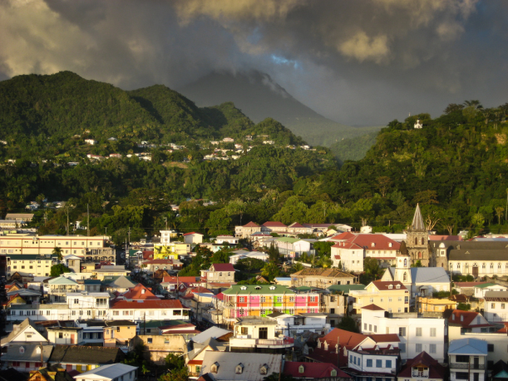
Major cities
The most major city by far in Dominica is Roseau with a population of 16,571.
The second biggest city is Portsmouth with a population of 3,633.

Slide 9
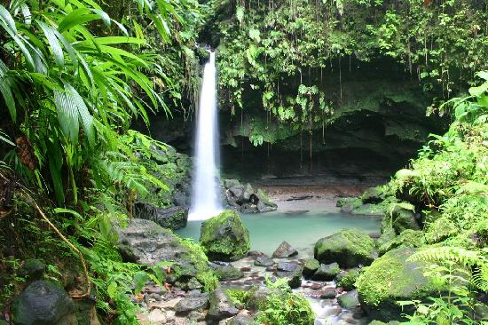
Bodies of water
Probably the most visited nature attraction in Dominica is the Emerald Pool. It is an emerald green pool fed by a 50-foot waterfall.
The scenic Boiling Lake in Dominica is the world's second largest boiling lake. The lake features gray bubbling water.
Freshwater Lake is Dominica's largest lake. Visitors can explore the area through a hiking trail that circles around the entire lake

Slide 10
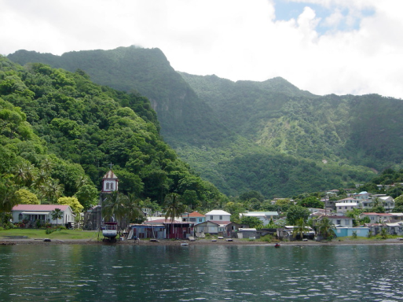
Major landmarks
Imperial Road: this twisty mountain road leads to many island sites in Dominica.
Soufriere Scottshead Marine Reserve: marine reserve, established to preserve the bay and marine area

Slide 11
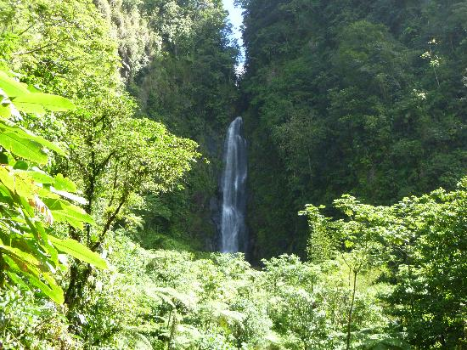
Major landforms
Two volcanoes in Dominica are Grenada and St. Vincent
Trafalgar Falls are the twin falls of Dominica and also the most popular attraction.

Slide 12
Culture
Dominica’s rich culture is a mix of English, French, African, and Carib people.
Dominica celebrates its independence in cultural celebrations that last up to 4 weeks.
Dominica is the only Caribbean island with a remaining population of pre-Columbian Carib Indians.

Slide 13
Culture cont.
Today, over 2,000 Caribs, properly known as the Kalinago, inhabit a 3,700 acre territory on the northwestern side of the island.

Slide 14
Economy
The main boost for Dominica’s economy is agriculture with bananas as the main product. This job is occupied by at least one-third of the country’s population.
This sector is highly vulnerable to weather conditions and to external events affecting prices.
agricultural diversification is a priority
Dominica has made some progress, with the export of small quantities of citrus fruits and vegetables and the introduction of coffee, patchouli, aloe vera, cut flowers, and exotic fruits such as mangoes, guavas, and papayas.

Slide 15
Interesting Facts
Dominica’s original name is Wai’tukubuli which means tall is her body.
Everywhere you go you see people walking with machetes
There are more active volcanoes here than anywhere in the world
There are 195 recorded species of fern, 75 kinds of orchids, 50 kinds of butterflies and 176 species of birds
Endangered giant leatherback turtles lay eggs here every year

Slide 16
Conclusion
In conclusion, Dominica is a very diverse land with microclimates, hot springs, rainforests, and woodlands, etc. It most definitely has more nature on it than any other island in the Caribbean. Its people are very diverse pertaining to all of the different origins (French, African, Carib, etc.) and its economy seems pretty successful overall since they have such fertile land used for agriculture.

Slide 17
questions
1. Which lake has a hiking trail leading all the way around it?
2. What is the main agricultural product?
3. Which two countries is Dominica located between?
4. Which DLP leader fought hard and led Dominica to independence?

Slide 18
bibliography
http://thecommonwealth.org/our-member-countries/dominica/history
http://www.dominica.dm/index.php/where-is-dominica
http://www.geonames.org/DM/largest-cities-in-dominica.html
http://dominicaschoolhelp.blogspot.com/2011/03/fun-facts-about-dominica.html

