Slide 1
Mexico
By: Sara kate taylor
7th Period
3/19/14

Slide 2
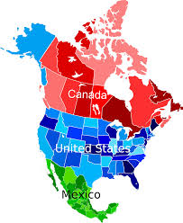
introduction
Mexico has the capital of Mexico City.
In Mexico the locals speak predominantly Spanish.
Mexico is located on the lower half of the North American continent.

Slide 3
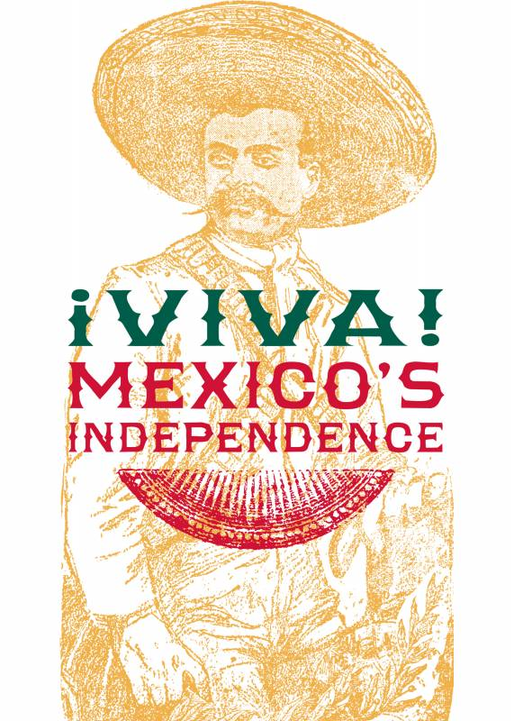
History
Before Mexico was free from Spain the feeling of independence was sweeping through the United States.
So an independence uproar began. After many battles against the rebels and the Spaniards. Mexico won its independence from Spain on September 16th of 1810.

Slide 4
History
September 16: Independence Day
On September 16, 1810 Mexico gained its independence from Spain and became their own country.
May 5: The Battle of Puebla
Cinco de Mayo is a celebration of the victory of the Mexican forces over French invaders in 1862. The French, who had a much stronger army were sent to Mexico, yet the brave Mexican army kept the invaders out of their country.
A famous leader from Mexico is Moctezuma, the ruler of the Aztecs.

Slide 5
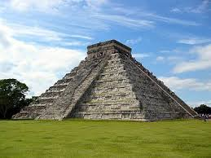
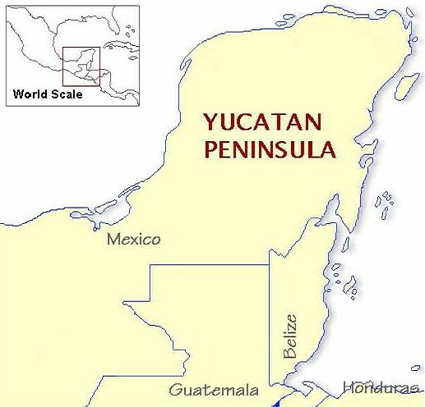
Geography
Major cities in Mexico include Guadalajara, Monterrey, Puebla, and Tijuana.
Chichen Itza is a major landmark ruin built from the Mayan people in the state of Yucatan.
A major landform in Mexico is the Yucatan Peninsula, formed by an asteroid.
Of course a major source of water for Mexico is the Gulf of Mexico which includes the Southern United States.

Slide 6
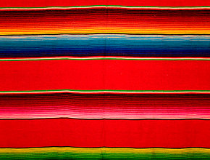
Culture
Mexico has a federal republic as well as the United States and their President is President Enrique Pena Nieto. The major religion in Mexico is Catholic.
The fashions in Mexico are heavily influenced by the US and Europe, but more traditional attire includes the sarape and sombrero.
A mariachi band plays traditional tunes as well.
The Mexican diet includes corn tortillas, with beans, rice, tomatoes, chili peppers and pork sausage.

Slide 7
culture
Holidays celebrated in Mexico include The Feast of Our Lady of Guadalupe, on December 12. The Day of the Dead celebrated over November 1st and 2nd. As well as their Independence Day of September 16th and Cinco de Mayo.

Slide 8
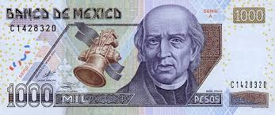
Economy
In Mexico their currency is the peso. The peso is just 7₵ of our American dollar.
The natural resources in Mexico include corn, wheat, soybeans, rice, cotton, coffee, fruit, cocoa, and wood products as well as petroleum.
13% of the land in Mexico is arable.
Tourism, manufacturing, and education are major jobs in Mexico.
Manufacturing areas are Saltillo, Guaymas, and Guadalajara.

Slide 9
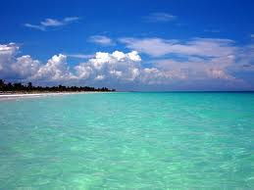
Climate
Hot summers and mild winters are normal for Mexico. Around the country the climate varies from tropical to desert.
The average yearly temperature is between 50° and 70°F.
The average rainfall is about 50 inches.
The northeast trade winds and the high pressure cell affect Mexico's climate.

Slide 10
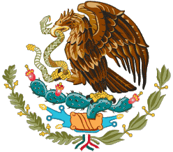
Interesting facts
The population in Mexico is 118,818,228 people.
The Aztecs received a vision that told them once they saw a golden eagle perched on a Nopal cactus with a serpent in its talon that then they could begin building the great city of Tenochtitlan. This image is depicted in the center of the flag.

Slide 11
Interesting facts
In Mexico cars, trains, and buses are the typical modes of transportation.
When going to Mexico a passport is necessary.
Some animals that are native to Mexico are the Mexican tree frog, bottlenose dolphin, garter snake, and the green iguana.

Slide 12
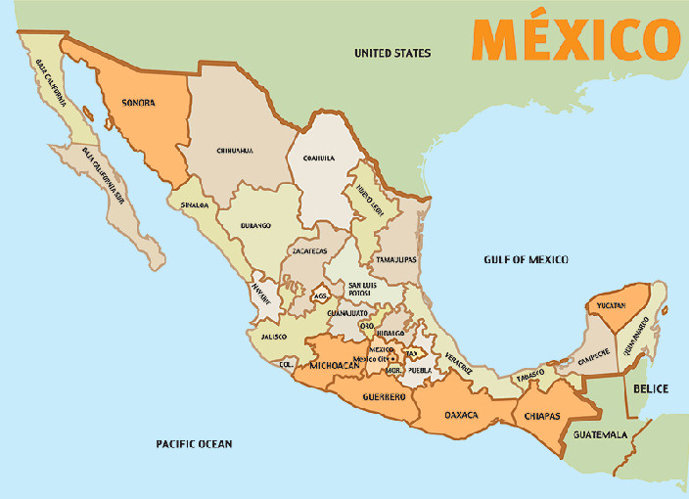
Conclusion
Mexico is a neighboring country in Central America with a variety of influences from the Aztec rulers, to colonization, to independence and the diverse people who live there today.

Slide 13
questions
Who did Mexico win its independence from?
What is the major religion in Mexico?
What currency is used in Mexico?
When traveling to Mexico what do you need to bring?

Slide 14
Citations
http://commons.wikimedia.org/wiki/File:North_America_map_coloured.svg
https://www.utexas.edu/news/wp-content/uploads/viva_mexico_300dpi.jpg
http://latinamericanhistory.about.com/od/thehistoryofmexico/tp/Important-Dates-In-Mexican-History.htm
http://www.transcaribbeantrust.com/times/2006/11/what-makes-a-yucatan-peninsula/
http://www.chichenitza.com/
http://www.mexican-clothing-co.com/mexican-rugs.html
http://www.livescience.com/38647-mexican-culture.html
http://nature.desktopnexus.com/wallpaper/217983/
http://www.bajainsider.com/baja-life/general-information/mexico-flag.htm#.UyZPIfmwJoc

