Slide 1
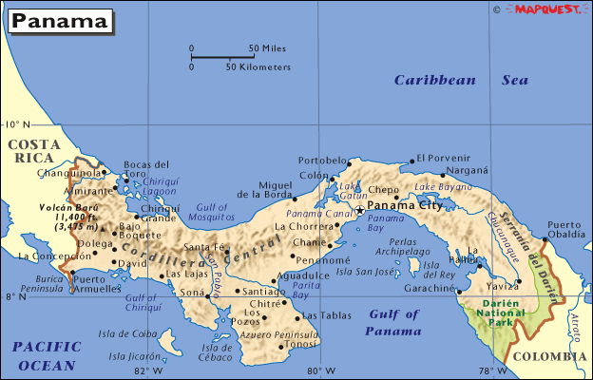
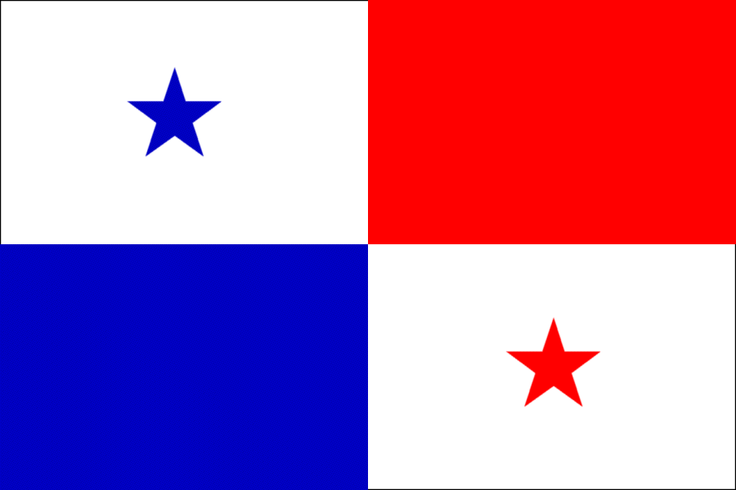
Panama Richard Graves
Spanish and English are spoken
Part of north America

Slide 2
.
Panama came to existence in 1903
Some of the presidents of panama are Mireya Elisa Moscoso Rodriguez de arias and Ricardo Martinelli
Panama gained independence from Colombia in 1903
Panama ceases to be a U.S. protectorate
Panama became a country in 1821

Slide 3
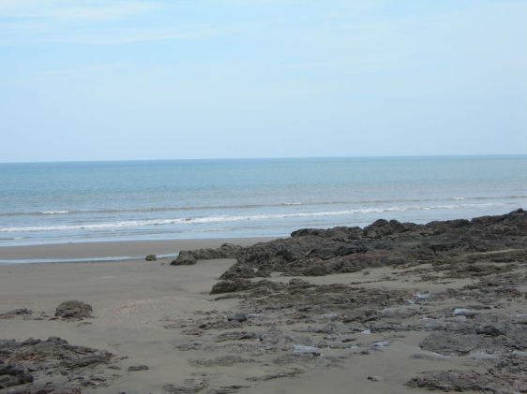
Major landforms, religions and cities
Las tablas beach
San Blas
La Palma
Volcan baru
Pearl islands
Lake bayano
Colon
Panama city
Most of panama is roman catholic
15% is protestant
1%is made of tribal religions
Is a constitutional democracy

Slide 4
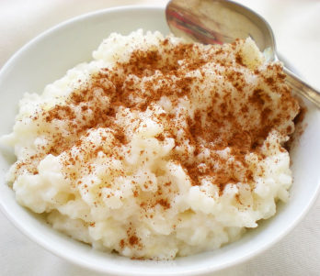
Culture
Arroz con leche (Rice pudding) is popular
Empanadas(stuffed turnovers) are very well known throughout the country and cheap
Popular forms of music are, pop, salsa, merengue, and bachata
Since the weather is warmer they wear the same clothes we do when its hot
They have some special holidays like, holy Saturday, carnival, colon day and so on

Slide 5
Natural resources
Clay, limestone and salt , are abundant
The communities near the beaches have a very good fishing industry
Some parts of the rainforests are used for farming and ranching
Some jobs that are offered can be, real estate, tourism, and fishing
American dollars and balboas are used as currency in most parts of the country, so your fine buying things

Slide 6
Climate
Panama is more or so tropical depending on the altitude and latitude
Temperatures are usually 84 degrees Fahrenheit year round
Its usually raining on most days
The average rainfall ranges from 70 inches in the capital to 129 inches in colon
The climate helps the country by benefiting arable and soil rich land

Slide 7
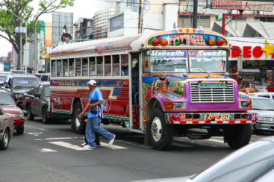
Interesting facts
The buses are modified for enjoyment when traveling through the city
The flag was made by Maria de la Ossa de Amador and was officially adopted by the “ley 48 de 1925”
The population is 3.7 million as of 2011
Main uses of transportation are car, bus, and taxi
Here are some weird laws ; it is illegal to walk around any part of the city without a shirt , transmitting sexual diseases is illegal
Some native animals are ocelots, pumas and armadillos

Slide 8
Conclusion
All in all panama is a very diverse and beautiful country. As for the food ; you cant go anywhere without trying some Panamanian cuisine. It has so much rich and interesting history ; its hard to not discover something new.

Slide 9
Questions
What type of currency is used ?
Name two foods eaten in panama?
What are some popular forms of music?
What are some well known natural recourses?

