Slide 1
The Bahamas
By: Quinn Roberts

Slide 2
Flag

Slide 3
Introduction
The Bahamas is a country of 700 different islands and cays, stretching southeast off the Florida coast. The islands form a country and Between the islands, there is much diversity. The capital of the country is Nassau. From pine trees, to white sand beaches, to limestone caverns, The Bahamas is a very diverse and interesting place.

Slide 4
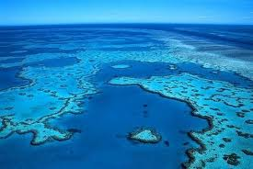
History
The name "Bahamas" comes from the Spanish baja mar meaning shallow sea, and is an archipelago of over 700 islands stretching over 258,998 square km in the western Atlantic Ocean. The Lucayan Indians were the original inhabitants: they lived throughout The Bahamas between 900 and 1500 A.D. Christopher Columbus (the first European visitor) made his first landfall in the New World on San Salvador (called Guanahani by the Lucayan Indians) in 1492.
The Barrier reef of the bahamas

Slide 5
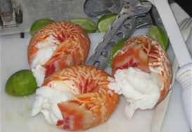
Food
The Bahamas are actually a group of more than 700 islands. Each island with it’s own individual foods, traditions and characters. Traditional food of these islands includes local meat and produce, but it has also been very strongly influenced by Southern American cuisine. As shown in the picture, Seafood is a common delicacy in the Bahamas.

Slide 6
Culture
Storytelling and folklore played a large role in the traditional entertainment of Bahamian communities, particularly before the advent of modern television. Many of these highly amusing tales also carry wise lessons. Bahamian storytelling has witnessed some revival, through the works of Patricia Glinton Meicholas and other authors. The population of the Bahamas is 95% Christian, of various denominations, primarily Methodist, Baptist, Anglican and Catholic. There are more churches per capita than in any other country. Bahamians' religious enthusiasm and high regard for education

Slide 7
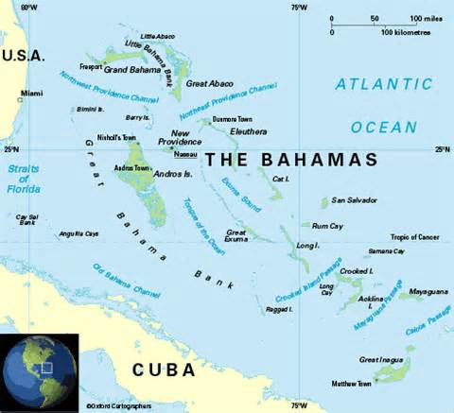
Landforms In the Bahamas

Slide 8
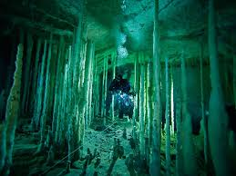
Geography of the Bahamas
The islands of the Bahamas vary greatly. However, a common characteristic of the islands is long, flat coral formations with some low rounded hills. There are forests and a large mountain on cat island and there are many limestone caves found in the area. The Geography of the Bahamas is extremely diverse.
A scuba diver explores one of the many underwater caves of the region

Slide 9
Economy of the Bahamas
The Bahamas economy is in stable state and is constantly developing. It is near the top of the list for the overall GDP of all the Middle and Southern American countries (17,000). This comes from the amazing views and tropical climates that attract so many tourists. 50% of the Bahamas economy is based on Tourism! The country continues to grow and is becoming more and more developed.

Slide 10
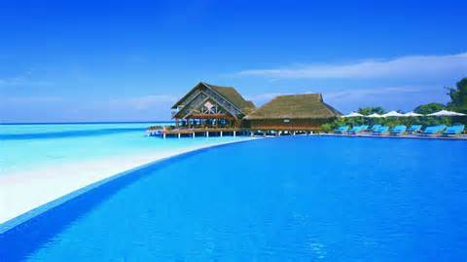
Climate
The average temperature of the Bahamas is a warm 70 degrees. Even at night the temperature only dips around 5 or 6 degrees lower than during the day. The hot days of the summer have highs of up to 80-90 degrees, which creates a place that is fun year round.

Slide 11
Interesting facts
1. The population is almost 400,000 people. The largest city is Nassau with about 240,000 people, located on the island of New Providence. Following Nassau is Freeport, West End, Coopers Town, Marsh Harbour, and Freetown.
2. Consisting of a chain of islands, there are more than 700 in total. The Bahamas is located southeast of Florida and northeast of Cuba.
3. The official language is English, other languages used include a Bahamian Dialect.
4. The name Bahamas comes from the Spanish words of “baja mar”, meaning shallow water or sea.
5. The original inhabitants of the Bahamas were the Taino people, from the 11th century AD, believed to have migrated from South America.
6. Junkanoo music is popular, especially during holidays.
7. The currency used is the Bahamian Dollar, BSD. The USD is also commonly accepted.
8. The yellow elder is the national flower (blooming throughout the year), the Lignum Vitae or Tree of Life is the national tree, the Flamingo is the national bird, and the Blue Marlin is the national fish.
9. Cuisine in the Bahamas is known for seafood, such as conch, rock lobster, land crabs, stew fish, and salt fish. Other commonly used ingredients include coconut, peas, and dumplings.
10. There are about 1.3 million people that visit the Bahamas every year, about 3 times the resident population.

Slide 12
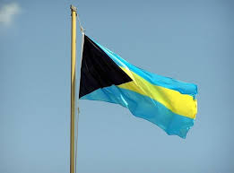
Conclusion
On July 10th, 1973 the Bahamas became an independent country. Under their parliamentary system tourism has become a big part of the countries economy, and has helped stimulate the economic system. The currency is the Bahamian Dollar ever since they became a independent nation independent from Great Brittan.

Slide 13
Questions
Approximately how many Islands make up the Bahamas?
What is the primary religion of the Bahamas?
What is the population of the Bahamas?
What day did it become a independent country?

Slide 14
Bibliography
http://thebahamasguide.com/
http://www.encyclopedia.com/topic/the_Bahamas.aspx
http://www.infoplease.com/country/bahamas.html

