Slide 1
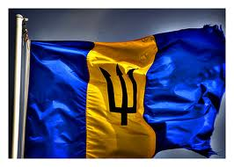
Barbados
Capital is Bridgetown
3/19/14
By: Max Booth
7th Period
$$f\left(x\right)=a_{0}+\sum_{n=1}^{∞}{\left(a_{n}\cos{\frac{nπx}{L}}+b_{n}\sin{\frac{nπx}{L}}\right)}$$

Slide 2
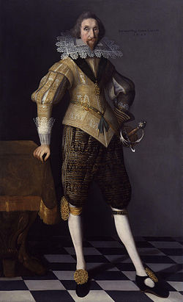
History
Barbados was first occupied by the British on February 17, 1627
In 1639 established 3rd ever parliamentary democracy
In the late 1600s had many problems such as plagues, droughts, and fires
Abolished slavery in 1834
Gained full independence in 1966
Famous for Samuel Lord who made a fortune plundering ships, built a mansion on the island which was a resort and recently burned down

Slide 3
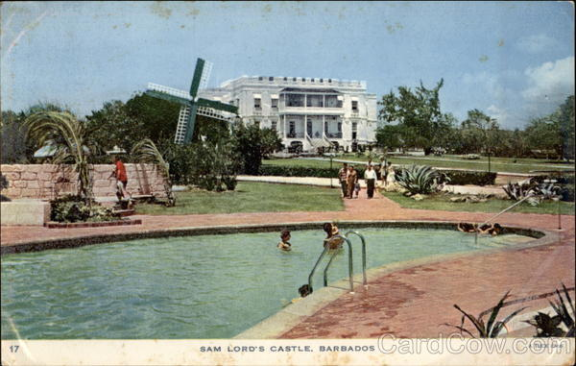
Geography
A Caribbean island in the North Atlantic
430 sq kilometers
Barbados is 2.5 times the size of Washington DC
A relatively flat and peaceful island with a tropical climate
has infrequent hurricanes and periodic landslides
Issues of pollution of waters by ships
Highest point is Mt. Hillaby 336m

Slide 4
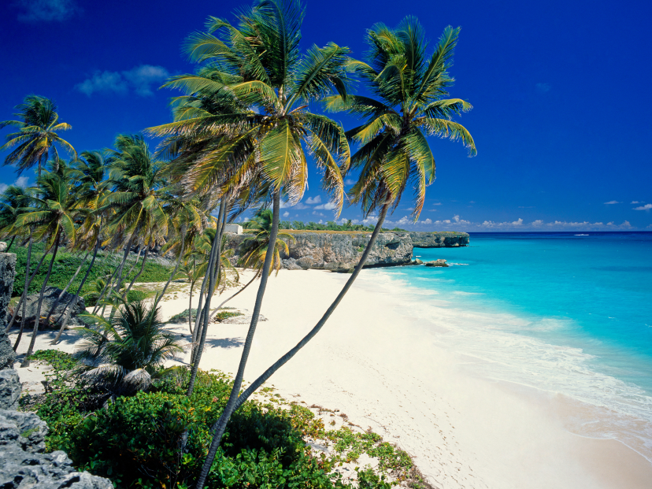
Culture
Bajans speak English
Has a population of 288,375
The culture of Barbados is a blend of West African and British cultures present in Barbados.
Barbadians (also known as Bajans) will surprise with their warmth
Coocoo and flying fish are the national dishes
In addition to the major holidays of the Christian calendar, Bajan holidays include New Year's Day (1 January), May Day (1 May), CARICOM Day (first Monday in August), Independence Day (30 November), and United Nations Day

Slide 5
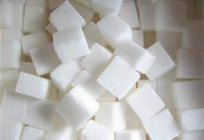
Economy
Barbados is the wealthiest and most developed country in the Eastern Caribbean and enjoys one of the highest per capita incomes in Latin America. Historically, the Barbadian economy was dependent on sugarcane cultivation and related activities. However, in recent years the economy has diversified into light industry and tourism with about four-fifths of GDP and of exports being attributed to services.
GDP (official exchange rate):$4.262 billion
Industries:tourism, sugar, light manufacturing, component assembly for export

Slide 6
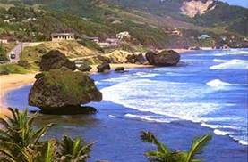
Climate
Barbados weather is generally warm and sunny all year round with an average daytime high of 86°F. In fact, Barbados has over 3,000 hours of sunshine each year!
The prevailing northeast tradewinds blow steadily so that although it is bright and sunny, it is not unbearably hot. The nights are usually slightly cooler.
The rain typically comes in quick showers. The dry season lasts from January to June

Slide 7
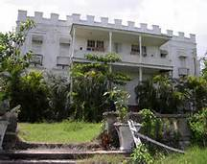
Interesting Facts
Samuel Lord was a plunderer who lived on the island of Barbados and would hang a lantern on the shore to lure ships believing they could dock there when really they would just crash and he would loot them making a fortune for himself.

Slide 8
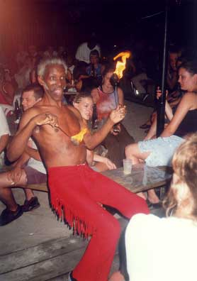
Conclusion
Barbados is a wonderful country rich for tourism and history and I have thoroughly enjoyed exploring it as a student. Thank you for watching.

Slide 9
Questions
1.)What is the name of the famous Bajan buccaneer?
2.) What is Barbaods’s highest point?
3.)What is a main industry of Barbados’s economy?
4.)When did Barbados earn its independence?

Slide 10
Bibliography
http://www.barbados.org/history1.htm
https://www.cia.gov/library/publications/the-world-factbook/geos/bb.html
http://www.lonelyplanet.com/barbados
http://wikitravel.org/en/Barbados

