Slide 1
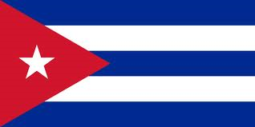
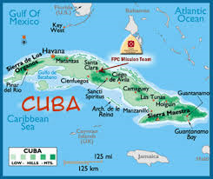
Cuba
By: Matt Maddox
Period 7

Slide 2
Introduction
The country is Cuba
The capital of Cuba is Havana
The major language in Cuba is Spanish
Even though Cuba is in central America it is considered part of the North American continent

Slide 3
History
Cuba got its independence in 1902
Some well – known rulers of Cuba were and are Osvaldo Dorticos Torrado, Fidel Castro, and Raul Castro which is the current ruler of Cuba
Some major events that happened to Cuba are in 1991 the soviet union collapses and Cuba’s economy is affected, 2001 Castro faints during a speech on TV, 2008 Fidel Castro resigned as ruler of Cuba
Spain and the United States were having growing tension which started the Spanish – American war until Spain withdrew in 1889, then Cuba gained independence in 1902

Slide 4
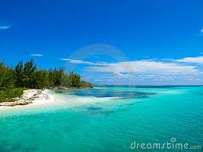
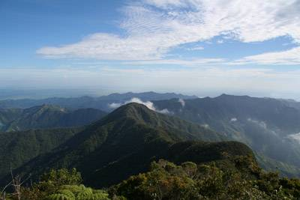
Geography
Some major landforms in Cuba are El Oriente which is a national park, Cayo Largo which is a Cuban island that is popular for tourists, and Sierra Maestra is the highest mountain in Cuba
The major landmarks are the Cathedral in Havana which is one the highlights, also the Morro Castle that was built in 1589 when Cuba was still under control of Spain, and it was a fort on the coast.
Bodies of water are La Laguna de Leche which is the biggest natural lake, cauto river, Toa Bay
Major cities are Havana, Trinidad, Baracoa, Vinales
Sierra Maestra
Cayo Largo

Slide 5
Culture
The clothing that they wear is more western clothing like blue jeans and t shirts, also button down shirts.
Cuba’s holidays are not that much different than ours except for that they celebrate their independence day on May 20th , but since the are mostly catholic they celebrate things like Christmas
The religion in Cuba is dominantly Roman Catholic
The government type is communist
The food like black bean soup is indigenous to Cuba, also stews and soups are commonly eaten with white rice or corn flower
Cubans listen to a wide variety of music especially Caribbean music

Slide 6
Economy
Cuba has many natural resources like nickel, wood, petroleum, avocadoes, bananas, cobalt, iron ore, copper, salt
Agriculture is important because it employs about 20 percent of the work population, and 30 percent of the land is used for agriculture
Agriculture and manufacturing are two of the most important jobs in Cuba
The currency in Cuba are pesos

Slide 7
climate
The average yearly rainfall in Cuba is 47.9 inches
The average yearly temperature for Cuba is about 70s – 80s
Cuba is effected a lot from the climate because in this area you get a lot of hurricanes so when this does happen the crops are sometimes destroyed so they have so restart especially when agriculture is so important in this country

Slide 8
Interesting facts
Cuba’s population is 11.27 million
The Cuban flag has a lot of meaning like the red stands for the blood uring independence wars, the three blue stripes represent the divided country during the independence wars, and the white stands for the purity of the cause
Cuba is mostly hot and warm so cool clothing would be the best to pack if you want to go and since they dress western you will not feel awkward. You should also reserve spots month's in advance since it is a communist country
Cuba has railways, roads, airports, waterways, ports and harbors
A strange law in Cuba is tourists cannot use the Cuban peso or shop in stores it is accepted
Some native animals are hutia, humming bird, cuban crocodile, cuban tree frog

Slide 9
Conclusion
I have learned a lot doing this research project. Some things that I have learned are interesting facts, how the climate affects the country, the kind of food that they eat, what music that they like to listen to, and how the country came into existence. Other interesting things are like what the flag stands for and some travel tips to assist people going to Cuba.

Slide 10
Questions
What is the population of Cuba?
What is the capital of Cuba?
What is one native animal to Cuba?
What year did Cuba get independence?

Slide 11
Works cited
https://www.google.com/search?biw=1093&bih=514&tbm=isch&sa=1&q=sierra+maestra+cuba&oq=sierra+maes&gs_l=img.1.1.0l10.4544.15155.0.18914.44.36.0.1.1.4.802.4791.26j4j2j2j1j0j1.36.0....0...1c.1.37.img..21.23.1585.KyEGmJ5Z4k8
http://en.wikipedia.org/wiki/History_of_Cuba
https://www.google.com/search?biw=1093&bih=514&q=date+of+cubas+independace&oq=date+of+cubas+independace&gs_l=serp.3..0i22i30.15635.27242.0.27620.41.32.1.1.1.4.168.2770.26j5.31.0....0...1c.1.37.serp..14.27.2262.4HK9H4AXK7E
http://en.wikipedia.org/wiki/Culture_of_Cuba
http://vagabond3.com/10-facts-you-should-know-before-visiting-cuba/

