Slide 1
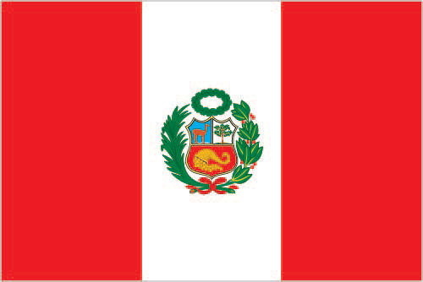
Peru
By Markus C. Smith
3/19/14
Period 7th

Slide 2
Introduction
Ancient Peru was the seat of several prominent Andean civilizations, most notably that of the Incas whose empire was captured by Spanish conquistadors in 1533. Peruvian independence was declared in 1821, and remaining Spanish forces were defeated in 1824. After a dozen years of military rule, Peru returned to democratic leadership in 1980, but experienced economic problems and the growth of a violent insurgency.

Slide 3
History
President Alberto Fujimori's election in 1990 led in a decade that saw a dramatic turnaround in the economy and significant progress in curtailing guerrilla activity. Nevertheless, the president's increasing reliance on authoritarian measures and an economic slump in the late 1990s generated mounting dissatisfaction with his regime, which led to his ouster in 2000.

Slide 4
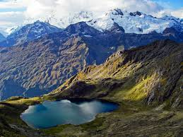
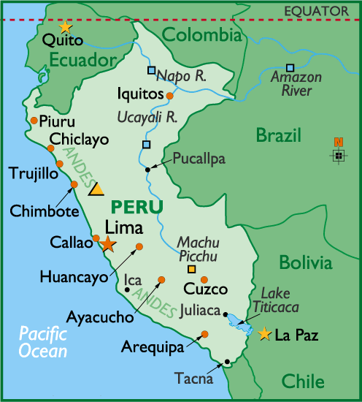
Geography
The location of Peru is West South America, bordering the South Pacific Ocean, between Chile and Ecuador. It is a total of 1,285,216 sq km. country comparison to the world: 20. 1,279,996 sq km of land. water: 5,220 sq km.
The Andes mountains

Slide 5
Culture
Amerindian 45%, mestizo (mixed Amerindian and white) 37%, white 15%, black, Japanese, Chinese, and other 3%.
18.85 births/1,000 population (2013 est.)country comparison to the world: 98
5.97 deaths/1,000 population (2013 est.) country comparison to the world: 165

Slide 6
Economy
GDP (purchasing power parity): $344 billion (2013 est.)
GDP - per capita (PPP): $11,100 (2013 est.)
Agriculture - products: asparagus, coffee, cocoa, cotton, sugarcane, rice, potatoes, corn, plantains, grapes, oranges, pineapples, guavas, bananas,

Slide 7
Climate
varies from tropical in east to dry desert in west; temperate to frigid in Andes.
Natural hazards: earthquakes, tsunamis, flooding, landslides, mild volcanic activity

Slide 8
Interesting Facts
Natural resources: copper, silver, gold, petroleum, timber, fish, iron ore, coal, phosphate, potash, hydropower, natural gas
Age structure:
0-14 years: 27.3% (male 4,184,330/female 4,040,096)
15-24 years: 19.2% (male 2,894,168/female 2,889,409)
25-54 years: 39.4% (male 5,715,542/female 6,161,540)
55-64 years: 6.9% (male 1,071,688/female 1,125,100)
65 years and over: 6.7% (male 979,854/female 1,086,208) (2014 est.).

Slide 9
Conclusion
Peru is a developed country, 3.42 million Telephones, 29.4 million Cellphones, 191 Airports, 5 Heliports.
The five major cities in Peru are, Lima, Arequipa, Trujillo, Chiclayo and Piura.
The Pacific Ocean is the body of water that is to the west of Peru. This ocean is the only large body of water that borders Peru.
The Andes Mountains is a major land form in Peru. The Amazonian jungle is another major land form in Peru.

Slide 10
Questions
List 5 agriculture products.
List 3 natural hazards
Comparison in the world for both births and deaths.

