Slide 1
El Salvador Capital: San Salvador
By: Lucas Bennett
3/20/14
7th

Slide 2
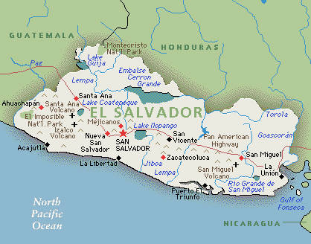
Introduction
El Salvador achieved independence from Spain in 1821 and from the Central American Federation in 1839. A 12-year civil war, which cost about 75,000 lives, was brought to a close in 1992. Today El Salvador is proud mountainous country located between Guatemala and Honduras. The native language of this country is Spanish, and this is where much of El Salvador’s culture stems from.

Slide 3
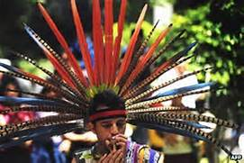
History
The Pipil Indians, descendants of the Aztecs, moved to El Salvador the 11th century
In 1525, Pedro de Alvarado conquered El Salvador
El Salvador declared its independence from Spain on Sept. 15, 1821
Became part of a federation of Central American states until1838.
El Salvador experienced numerous revolutions and wars against other Central American republics.
In 1969, El Salvador invaded the country of Honduras after its landowners deported Salvadorans
The four-day war became known as the “football war” because it broke while there was a soccer game between the two countries
Additionally, From 1931 to 1979 El Salvador was ruled by a series of military dictatorships

Slide 4
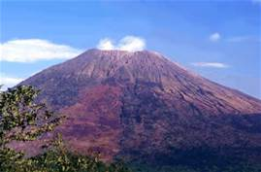
Geography
Izalco volcano
El Salvador is a small tropical country, and is littered with mountains, with a narrow coast line on the west.
8,260 square miles
Divided into 3 regions (southern coastal belt, the central valleys and plateaus, and the northern mountains)
Tropical Climate, with rainy season
Heavy volcanic activity in the Capital, San Salvador
Izalco volcano was born in 1770 and is the youngest volcano in El Salvador
Only Central American Country without Caribbean
Coast line
Environmental issues include: deforestation; soil erosion;
water pollution; contamination of soils from disposal of toxic waste

Slide 5
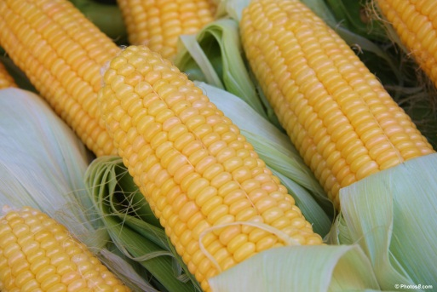
Culture
The Culture of the typical Salvadoran is one which is diverse and rich.
Official language is Spanish, but native tongues are often spoken
Major ethnic group is Mestizo (86.3% )
Major Religions are Roman Catholic (57.1%), and Protestant (21.2%)
Corn is a staple diet of this region and eaten with almost every meal
Most Salvadorans are very poor subsistence farmers, but there is limited commercial farming

Slide 6
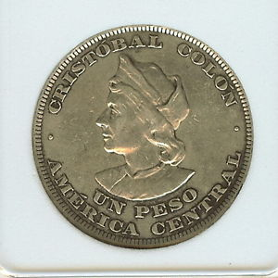
Economy
The smallest country in Central America, El Salvador has the third largest economy in the region.
El Salvador was the first country to except the Dominican Republic-Central American Free Trade Agreement
Increased the export of processed foods, sugar, and ethanol.
Debt has been growing over the last several years.
El Salvador was awarded a $277 million compact with the Millennium Challenge Corporation (MCC)
In northern region, a conflict zone during their civil war, through investments in education, public services, and transportation infrastructure has increased once again
The Peso is the countries official Currency

Slide 7
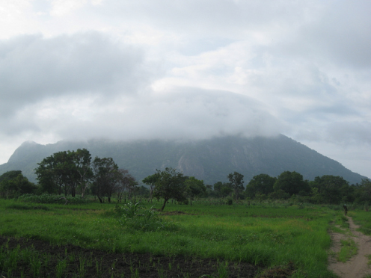
Climate
El Salvador has a tropical climate with separate wet and dry seasons
Temperatures change mostly with elevation and show little seasonal change.
The Pacific lowlands are the hottest, and the central plateau and mountain areas are colder
The rainy season, invierno, or winter in English, extends from the months May to October
The Pacific lowlands are the hottest region, with annual averages ranging from 25°C to 29°C or around 82°F

Slide 8
Interesting Facts
Although El Salvador is a third world country, it still is considered to be an amazing democracy
El Salvador is known for its cocaine. The country is also noted for the easy availability of the drug.
In El Salvador the blue stripes symbolize unity, and the white symbolize peace.
El Salvador is one of the world’s most popular surfing areas
El Salvador, is also known for the beauty of its women

Slide 9
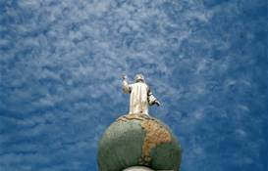
Conclusion
Overall El Salvador is a beautiful country. With people and a culture as interesting and diverse as the country history, El Salvador is must visit. I feel honored to have researched this country and hoped you have enjoyed the presentation.

Slide 10
Questions
What is El Salvador's Capital?
What Indians moved and inhabited this area?
What is the youngest volcanoes in El Salvador?
What are 2 things EL Salvador is known for?

