Slide 1
CHILE
Kwame(7th)
3/19/14

Slide 2
Introduction
Chile is a country of startling contrasts and extreme beauty with attractions from the towering volcanic peaks of the Andes to the ancient forests of the Lake District. In this presentation you should expect to see the geography of this country, its history, its economy,culture,climates,environmental problems and some other interesting facts

Slide 3
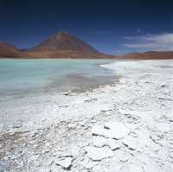
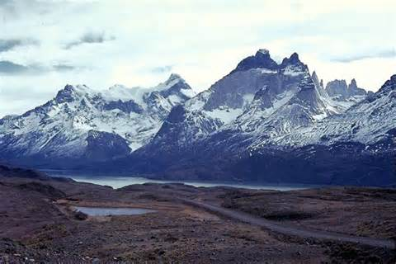
Climate.
Chile can be divided into three major climate areas-very arid in the far north,cool and damp in the south and a temperate Meditteranean climate in central Chile.Since Chile lies deep in the southern hemisphere,the seasons fall at opposite times of the year from the northern hemisphere.The summer months are December,January and February while June,July and August are winter months.When its spring in North America ,it is autumn in Chile and vice versa.In Satiango,the seasons are well defined with hot summers(maximum 82 degrees-90 degrees) and short winters as low as (32 degrees).

Slide 4
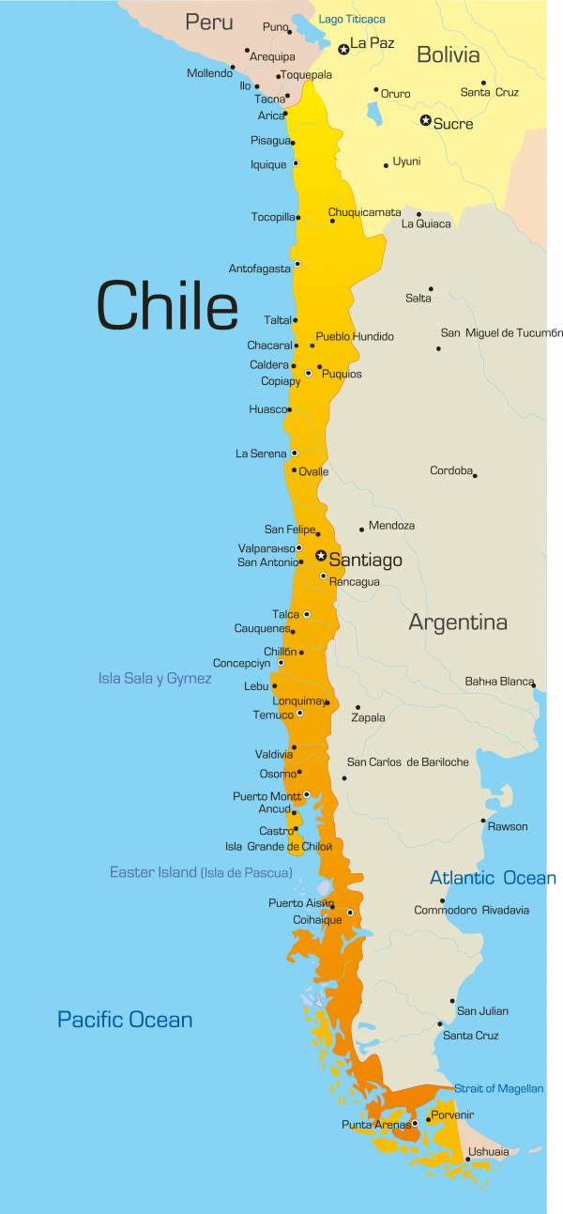
Geography
Chile is located south of Peru and west of Bolivia and Argentina.One-third of Chile is covered by the towering ranges of the Andes.In the North is the driest place on earth, the Atacama desert, and in the center is a thick populated valley with most of Chiles arable land. Chile's latitude and longitude is 30° 00' S and 71° 00' W and is has an area of 756,102 sq. km.

Slide 5
History
Prior to the arrival of the Spanish in the 16th century, the Inca ruled northern Chile while the Mapuche inhabited central and southern Chile. Although Chile declared its independence in 1810, decisive victory over the Spanish was not achieved until 1818. In the War of the Pacific (1879-83), Chile defeated Peru and Bolivia and won its present northern regions. It was not until the 1880s that the Mapuche were brought under central government control. After a series of elected governments, the three-year-old Marxist government of Salvador Allende was overthrown in 1973 by a military coup led by Augusto Pinochet, who ruled until a freely elected president was inaugurated in 1990. Sound economic policies, maintained consistently since the 1980s, contributed to steady growth, reduced poverty rates by over half, and helped secure the country's commitment to democratic and representative government. Chile has increasingly assumed regional and international leadership roles befitting its status as a stable, democratic nation. In January 2014, Chile assumed a nonpermanent seat on the UN Security Council for the 2014-15 term.

Slide 6
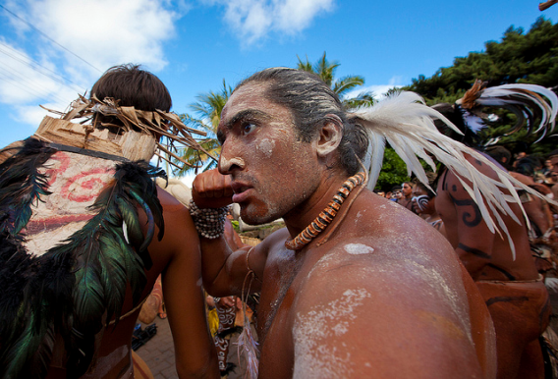
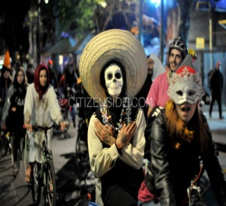
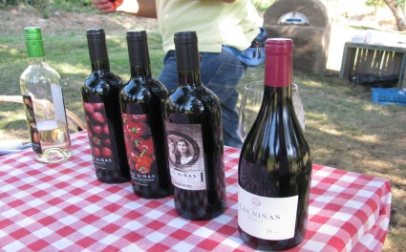
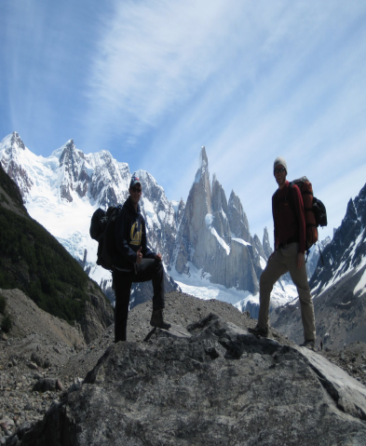
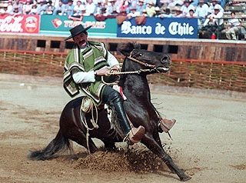
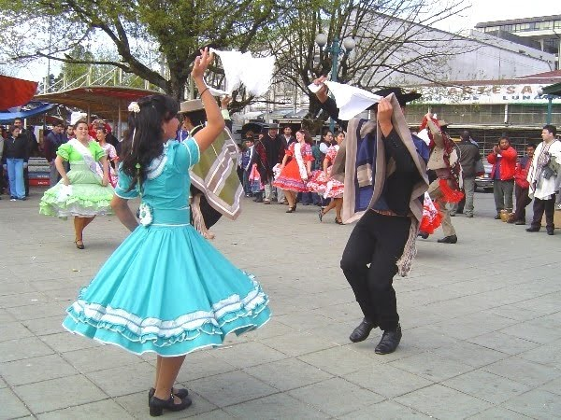
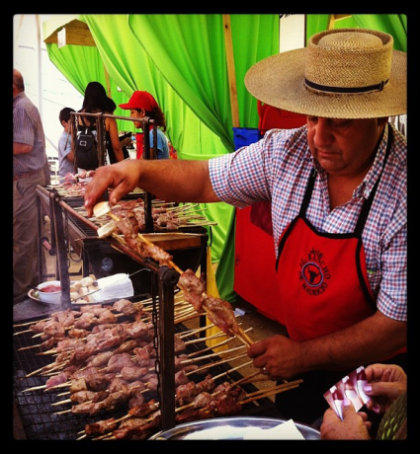
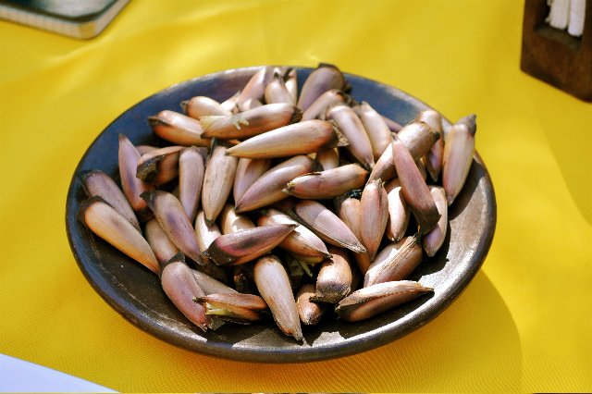
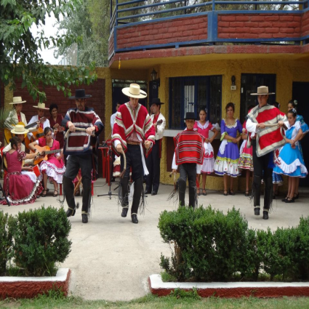
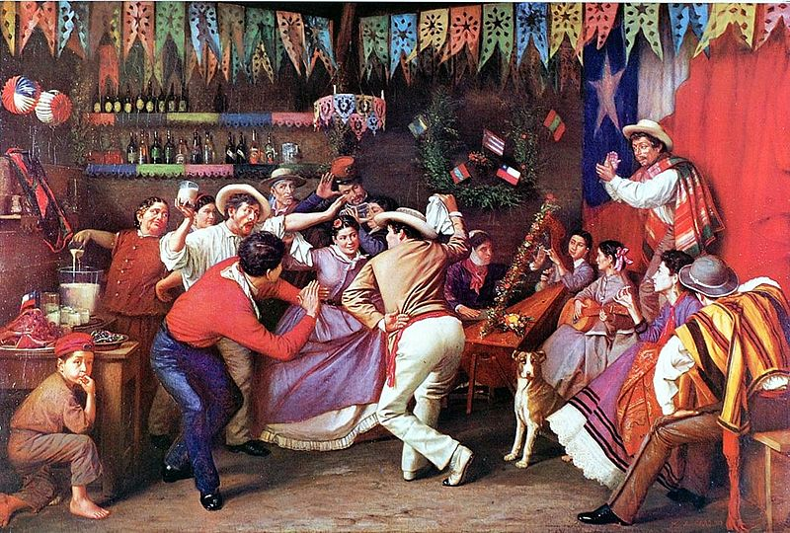
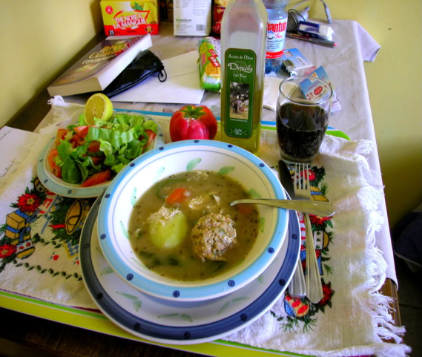
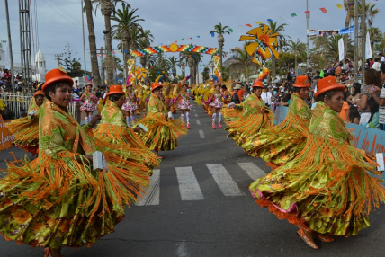
CULTURE
have

Slide 7
Culture
There are 17,363,984 people in Haiti and all these people come from different tribes and have different cultures and backgrounds. 88.9% are white and non-indigenous, 9.1% are Mapuche , 0.7% are Aymara and 1% are other indigenous groups like the Rapa Nui, Likan Antai, Quechua, Colla, Diaguita, Kawesqar, and Yagan.Spanish is the official language of Chile but 10.2% of the people also speak English.According to the Chile National Statistics Institute,70% of the population are Roman Catholic,15% are Evangelical,0.9% members of the Church of Latter-day saints,1% are Jehovah witness,0.1% are Jewish and the rest are Atheist or Agnostic.Chile is known for its fantastic seafood,grilled meats,stews,empandas,pisco and excellent wines.There are different types of food like Empandas,Fritas de Queso,Pan Con Palta and Cazuela.

Slide 8
Culture continued
Appearance is important to Chileans who favor sophisticated European styles.It is important to be neatly dressed for all events.Chileans dress formal to go to work but at home casual clothing is preferred.If a woman chooses to wear dresses so attractive,they must present it in an elegant way so they don’t get misundertood.The men usually dress in dark colors like black,brown,grey etc in formal and casual occasions.It is not common to see people wearing orange,yellow and other bright colors.Basically, most Chileans follow the European way of fashion.

Slide 9
Economy
Chile's economy is based on the export of minerals, which account for about half of the total value of exports. Copper is the nation's most valuable resource, and Chile is the world's largest producer. Agriculture is the main occupation of about 15% of the population; it accounts for about 6% of the national wealth, and produces less than half of the domestic needs. The Vale of Chile is the country's primary agricultural area; its vineyards are the basis of Chile's wine industry. Grapes, apples, pears, onions, wheat, corn, oats, peaches, garlic, asparagus, and beans are the chief crops. Livestock production includes beef and poultry. Sheep raising is the chief pastoral occupation, providing wool and meat for domestic use and for export. Fishing and lumbering are also important economic activities.

Slide 10
Economy continued
Chile's industries largely process its raw materials and manufacture various consumer goods. The major products are copper and other minerals, processed food, fish meal, iron and steel, wood and wood products, transportation equipment, and textiles.
The dependence of the economy on copper prices and the production of an adequate food supply are two of Chile's major economic problems. Chile's main imports are petroleum and petroleum products, chemicals, electrical and telecommunications equipment, industrial machinery, vehicles, and natural gas. In addition to minerals, it also exports fruit, fish and fish products, paper and pulp, chemicals, and wine. The chief trading partners are the United States, China, Brazil, Argentina, and South Korea. Chile’s GDP was about $335.4 billion as of 2013.

Slide 11
Environmental problems.
Chiles main environmental problems are deforestation , the resulting soil erosion and the pollution of its air,water and land.Air pollution from industry and transportation and water pollution are especially acute in urban centres where the population has doubled in the last 3 years.Untreated sewage poses the major threat to the nations water quality.While 99% of its urban dwellers have pure drinking water,only 58% of its rural dwellers have the same success

Slide 12
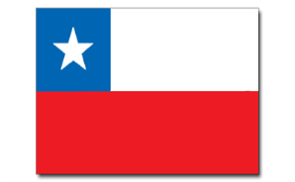
Interesting Facts.
Chile is the longest north-southern trending country in the world.
Chile is home to 17 million people.
Found in North Chile, the Atacama Desert is the driest place on earth, with an average rainfall of less than 0.05 a year.
According to Ancient and Heraldic traditions much symbolism is associated with colors. The colors on the Chile flag represent the following
White:The snow of the Andes.
Red:Represents the blood of patriots who fought for independence
Blue:The Blue of the skies.
The Chile five pointed Single star is to emphasise the fact that Chile is an Unitarian republic as opposed to a Federal republic.
Since 1967, it has been compulsory to hang the Chilean flag from every public building in the country during Fiestas Patrias. The flag must be in perfect condition, hung correctly from a white pole or from the building front. Failure to do so can result in fines of up to 40,000 pesos (about US$ 80).
Chileans call their country: país de poetas (country of poets), for good reason too, the country's two Nobel Prize winners both won in Literature. Gabriela Mistral in 1945, and the country's most famous poet, Pablo Neruda in 1971.

Slide 13
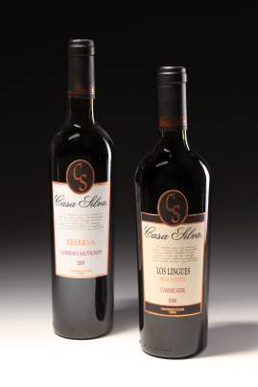
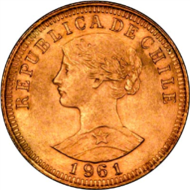
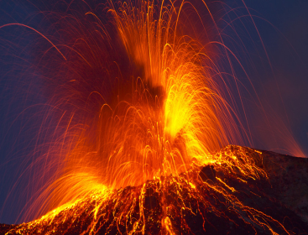
Continuation of Facts.
Chiles national sport is soccer
Chile has a chain of about 2,000 volcanoes dotted along the Andes, it has the second largest volcano chain in the world after Indonesia.
Worldwide 9,800,000 people drink daily a glass of Chile.
The Chilean Peso is the national currency of Chile and is equivalent to about 17 cents.

Slide 14
Conclusion
Chile is a wonderful country with a lot of nice tourist attractions,great weather,great culture and wonderful people.There are a lot of great tourist attractions to visit in Chile like the Easter Island Stone Heads,San Pedro de Atacama, and Lake District

Slide 15
Lets Review.
What are some of Chiles environmental problems?
What are the three main climates that Chile can be divided into?
What is the driest place on earth?
When did Chile declare its independence?

Slide 16
Links.
https://www.cia.gov/library/publications/the-world-factbook/geos/ci.html
http://www.infoplease.com/encyclopedia/world/chile.html
http://www.chileculture.org/chile-history-timeline/
http://chilefishing.com/chilehistory.htm
www.swyaa.org/resources/handbook/Chile.htm
http://www.nationsencyclopedia.com/Americas/Chile.html#b
http://www.sciencekids.co.nz/sciencefacts/countries/chile.html

