Slide 1
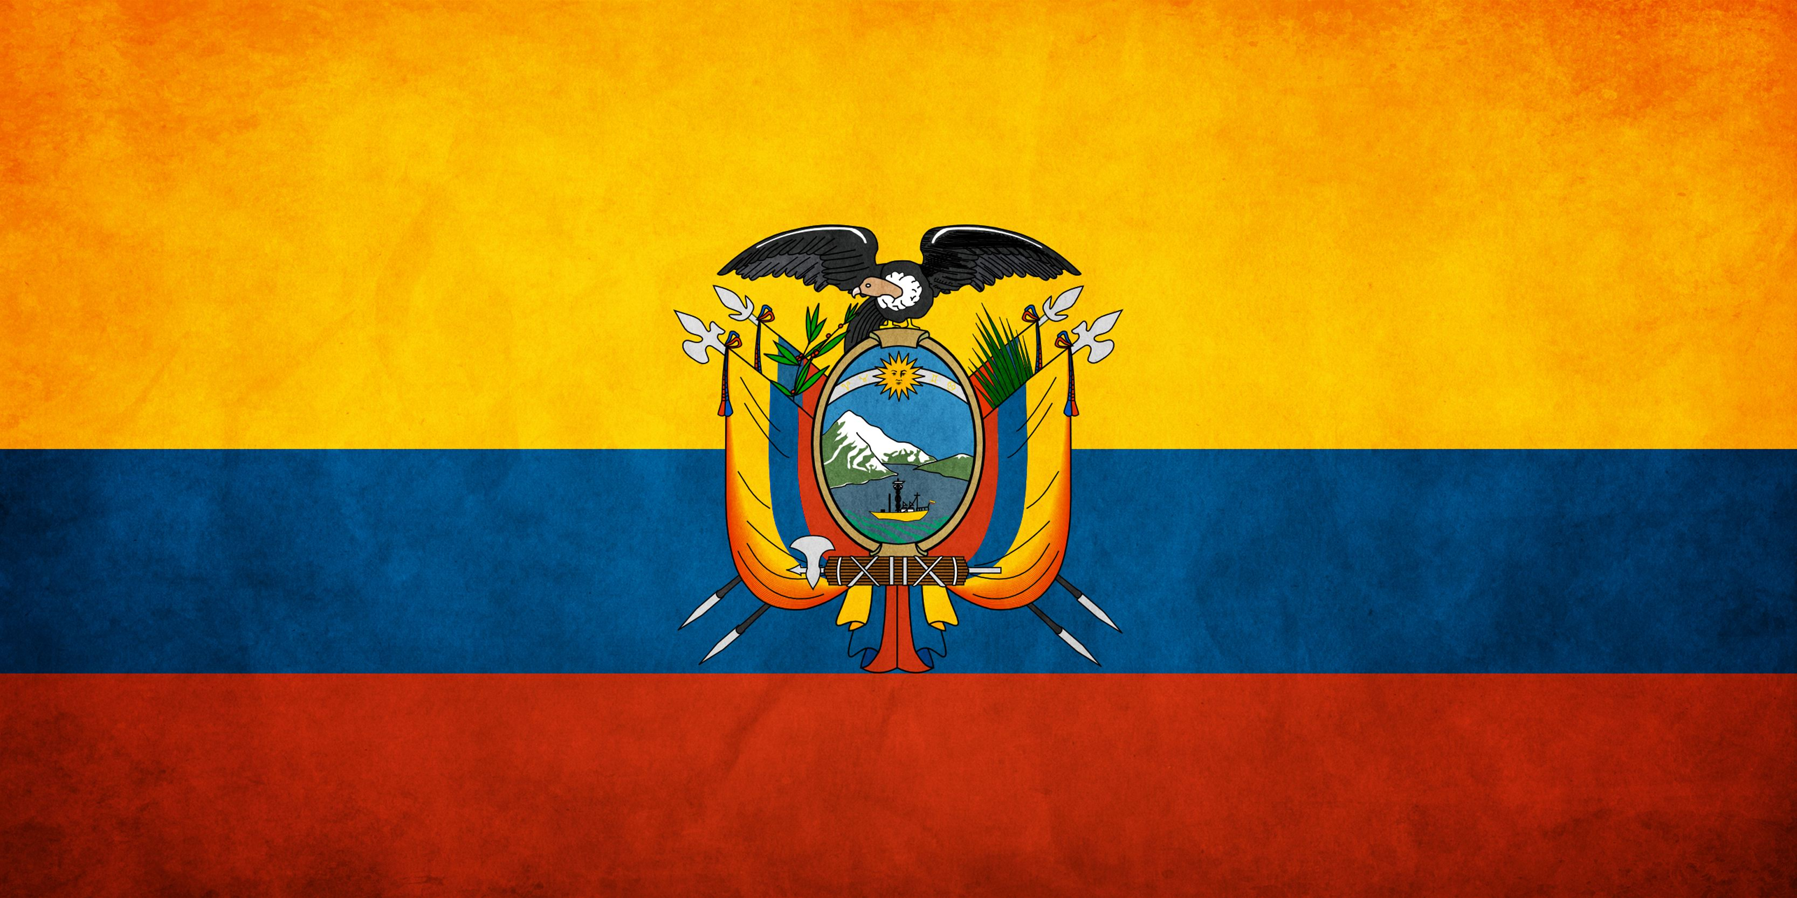
ECUADOR
By:Keegan
7th per.

Slide 2
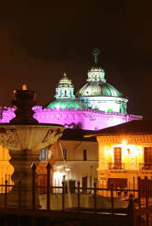

Ecuador
The capitol of Ecuador is Quito.
The major language spoken in Ecuador is Spanish.
Ecuador is located on the continent of South America.

Slide 3
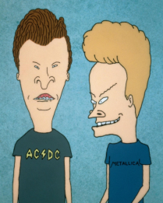
HISTORY
Ecuador became in independent country on May 24, 1822
Michael Craig Judge is a well known Ecuadorian animator and you may recognize some of his works like “King of the Hill” and “Beavis and Butt-head”
After winning the Battle of Pichincha, near Quito. Ecuador joined Simón Bolívar's Republic of Gran Colombia joining with modern day Colombia and Venezuela. Only to become a republic in 1830.

Slide 4
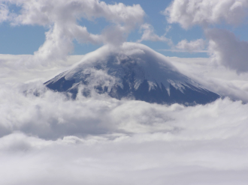
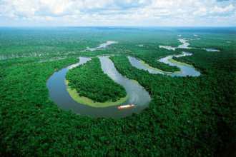
Geography
The Cotopaxi is part of the Andes mountains that runs through Ecuador
The Galapagos Islands are a small archipelago of volcanic islands belonging to Ecuador in the eastern Pacific Ocean.
The amazon is the second largest river in the world and it runs through Ecuador.
One of the major cities in Ecuador is Quito witch is the capitol

Slide 5
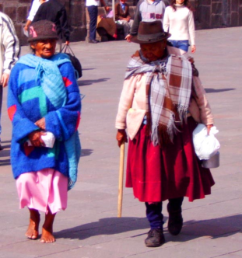
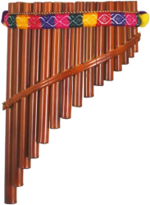
Culture
Ecuadorian people wear colorful clothing.
Ecuador has some of the same national holidays as us like independence day and labor day.
Ecuadorians like citrusy foods and put fruit in almost anything.
The most commonly used musical instrument in Ecuador is the panpipe.
The main religion in Ecuador is Roman Catholic.
Ecuador government is a presidential republic.

Slide 6
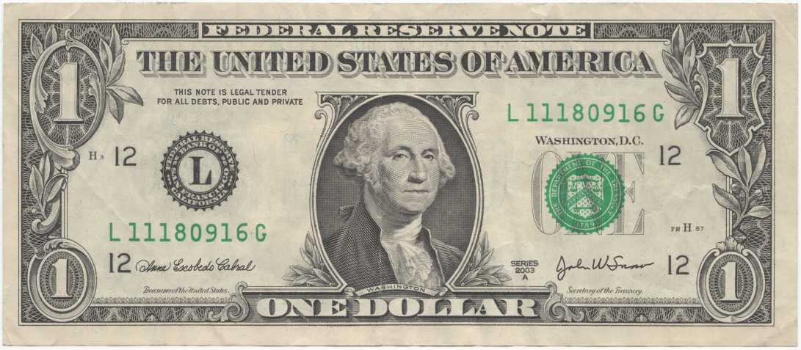
Economy
Ecuador has land which is rich in petroleum. Main fishing products include herring and mackerel. Other natural resources include timber and hydropower.
Only 4.51% of Ecuador's land is arable.
The currency of Ecuador is the United States Dollar.

Slide 7
Climate
The general climate of Ecuador is subtropical highland
The average annual rainfall for Ecuador is 40.8 inches
The average yearly temperature is 67(f)
This climate makes Ecuador have cold and heavy rainy days and also have really sunny and dry days

Slide 8
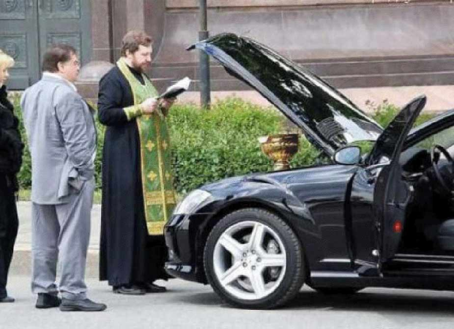
Interesting facts
The colors of the flag is yellow for the diversity in the country, blue for the sky and the sea, and red for the blood of those who fought for independence.
Garbage trucks play music just like ice cream trucks in the US.
Priests ask for $30 to bless your car.

Slide 9
Questions
What is the capitol of Ecuador?
When did Ecuador become an independent country?
What religion is most commonly practiced in Ecuador?
What form of currency is used in Ecuador?

