Slide 1
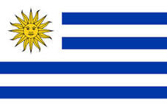
Uruguay: The Southern Nation
By: Jeremy Jackson 7th Period

Slide 2
History
Uruguay was created as a buffer state between Brazil and Argentina during their years of independence. It was created peacefully, unlike some of the other latin nations

Slide 3
Geography
Uruguay is mostly rolling plains and low hills with fertile coastal lowland. The natural resources consist of arable land, hydropower, minor minerals, fish

Slide 4
Culture
Uruguay’s dominating religion is Roman catholic and its top ethnic group is White People. The nation’s dominating language is Spanish and is rated high for its developments throughout latin america. Prior to European settlement, Uruguay was inhabited by indigenous people, the Charrúas.

Slide 5
Economy
Uruguay has a free market economy characterized by an export-oriented agricultural sector, a well-educated work force, and high levels of social spending. The economical troubles the world market has affected Uruguay’s vigorous growth but was not effective enough to place the country into a recession. The major trading partners, according to a 2010 list, are U.S., Brazil, Germany, Argentina, Paraguay, China, Venezuela
The components that make up the economy are shown here:
agriculture: 7.5%
industry: 21.5%
services: 71%
As you see, most of Uruguay’s economy is fueled by services, mostly tourism

Slide 6
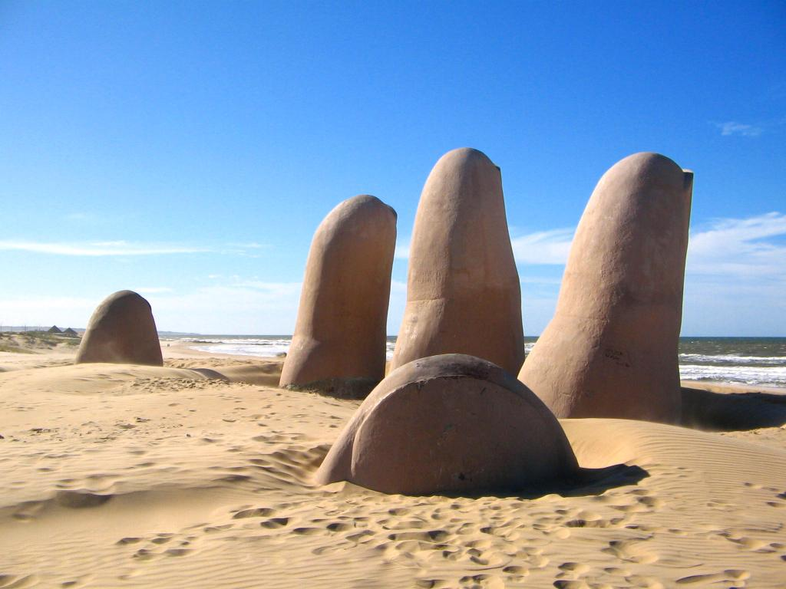
Famous Landmarks and Cities
.Uruguay’s most populated city is their capital,
Montevideo,
with over 1.2million people with in it.
.The Monumento Al Ahogado is a structure
built in the sand in the shape of a hand made
by Mario Irarrazabal.
It is made of plastic, steel, and concrete.

Slide 7
Climate
The climate of Uruguay, like most southern nations, have a warm tropical climate that support large forests. and warm waters. Freezing temperatures are almost unknown by most of the Uruguayans

Slide 8
Facts
. Football is Uruguay most populated sport
.Uruguay was disputed between argentina and brazil, but gained independence from both of them.
.

Slide 9
Mini-Quiz
.What is Uruguay’s most populated city?
.What is Uruguay’s currency system?
. What is the Monumento Al Ahogado?

