Slide 1
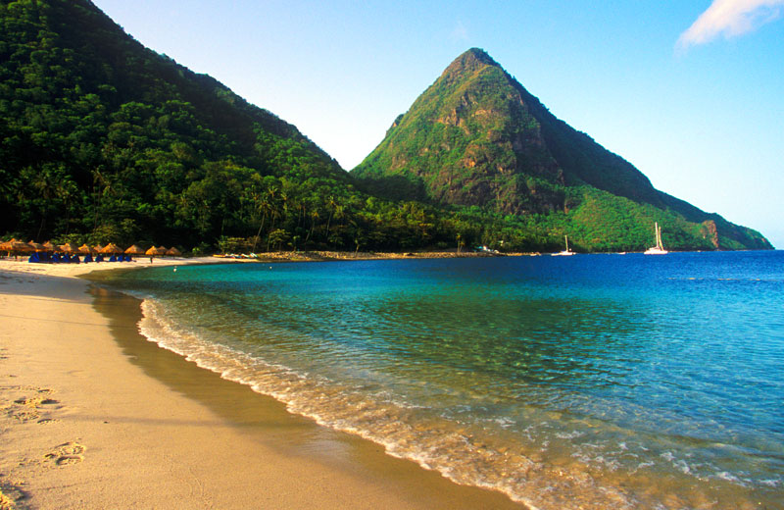
St. Lucia

Slide 2
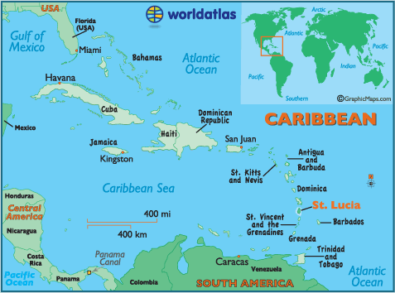
Intro
St. Lucia Map
Capital
-Castries
Major Language
-American English
Location
-North America (Lesser Antilles)
Background is St. Lucia’s flag

Slide 3
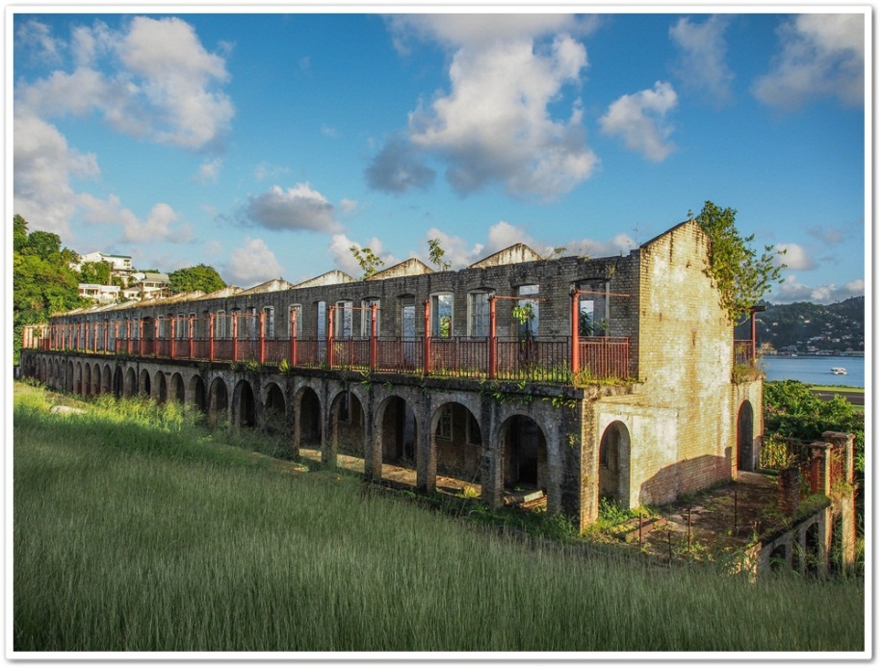
History
St. Lucia was ruled by the England and French during the 17th and 18th century (changing possession 14 times). They had ceded to the UK in 1814. Self-government was granted in 1967 and On February 22, 1979, St. Lucia became an independent nation (this was one of the major victories in St. Lucia), but remains a member of the British Commonwealth..
One famous (person) actor who is a St. Lucian by birth was the butler in the sitcom “The Fresh Prince of Bellaire.” His real name is Joseph Marcell and he played Geoffrey during the show. He was born in St. Lucia on the 18th of August 1948

Slide 4
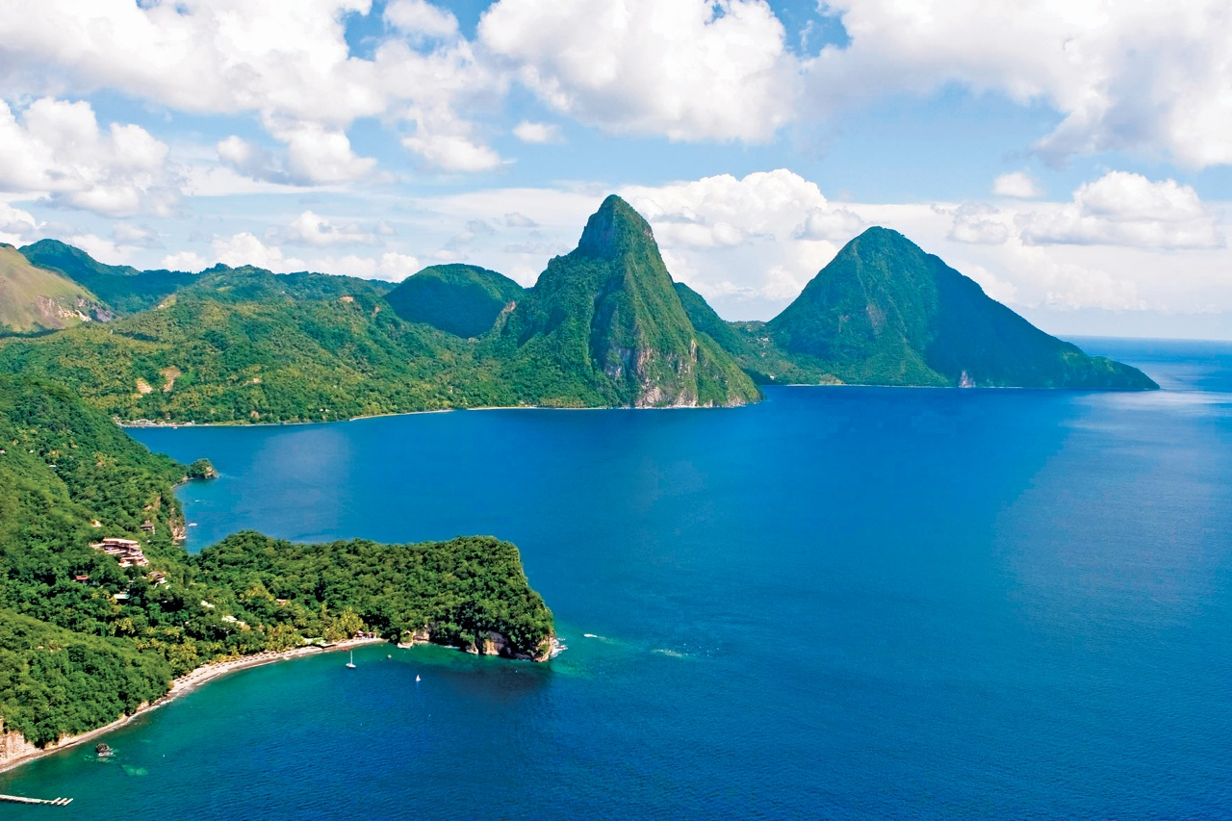
Geography
St. Lucia is located in the Caribbean, it is an island between the Caribbean Sea and North Atlantic Ocean, north of Trinidad and Tobago, it also lies just south of Martinique.
St. Lucia has a origin of volcanic activity. Wooded mountains go from north to south and from them gush many streams into rich, fertile valleys.
One famous landmark in St. Lucia is The Pitons (twin mountain peaks) which are the symbol of St. Lucia.
Castries in the main city in St. Lucia and the one with the biggest population of 20,000
St. Lucia is also rich with natural resources like forests, sandy beaches, minerals (pumice), mineral springs, geothermal potential
Background picture is based on the mountainous regions of St. Lucia

Slide 5
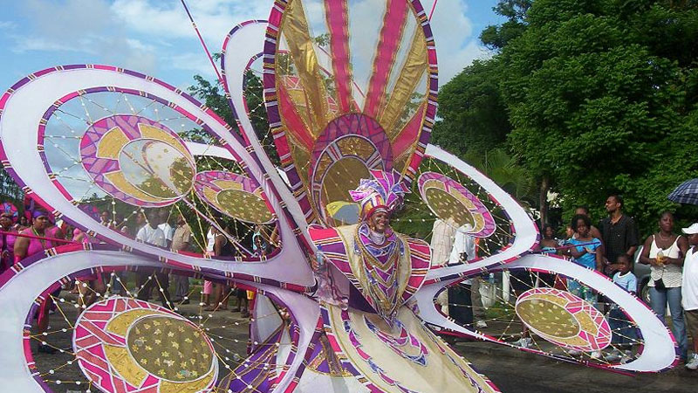
Culture
One of the best way of showing St. Lucia's cultural heritage is in its dining. The fertile, volcanic soil of the island give an abundant supply of produce. St. Lucia's abundant tropical fruits include mangoes, papayas, pineapples, sour-sops, passion-fruit, guavas, bananas and coconuts. Local chefs combine the island's fresh produce with a wide variety of equally fresh seafood to create enticing curries. Callao soup, made from a leafy green similar to spinach, is the national dish. The island's outstanding cuisine has gained international recognition by obtaining several gold medals in the regions most prestigious culinary competitions.
Most of St. Lucia ethnic groups are black/African descent 85.3%, mixed 10.9%, East Indian 2.2%, other 1.6%, unspecified 0.1% (2010 est.)
The religions in St. Lucia would include Roman Catholic 61.5%, Protestant 25.5% (includes Seventh Day Adventist 10.4%, Pentecostal 8.9%, Baptist 2.2%, Anglican 1.6%, Church of God 1.5%, other Protestant .9%), other Christian 3.4% (includes Evangelical 2.3% and Jehovah's Witness 1.1%), Rastafarian 1.9%, other 0.4%, none 5.9%, unspecified 1.4% (2010 est.)
One of St. Lucia’s holiday is Saint Lucia's Day it is the church feast day dedicated to Lucia of Syracuse celebrated on Dec. 13.
Background shows one of the festivals attended in St. Lucia

Slide 6
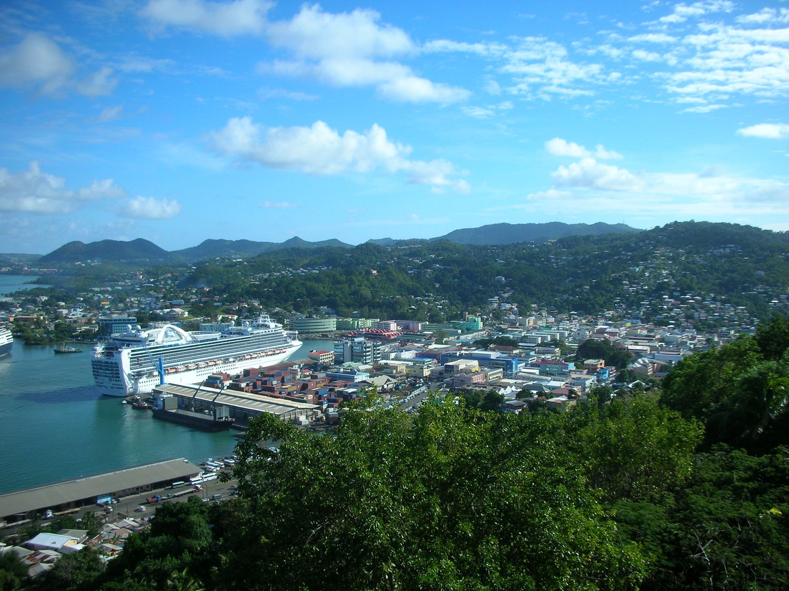
Economy
The currency for St. Lucia is the East Caribbean dollar.
Tourism is the fastest growing sector of the economy with agriculture and manufacturing making a significant contribution to employment and gross domestic product. Construction activity continues to increase with the development of the tourism sector and the implementation of several capital infrastructure projects.
The majority of St. Lucia’s land is used for farming (bananas)
The jobs of St. Lucia would categorize as
-agriculture: 3.1%
- industry: 17.4%
-services: 79.5% (2013 est.)

Slide 7
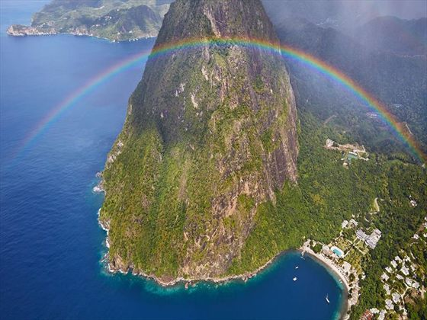
Climate
St. Lucia’s climate is tropical, moderated by northeast trade winds; dry season from January to April, rainy season from May to August.
St. Lucia’s average rainfall would be around 60 inches yearly due to being located in the Caribbean.
The annual temperatures for St. Lucia throughout the year is ranged from 84 to 78 degrees Fahrenheit.

Slide 8
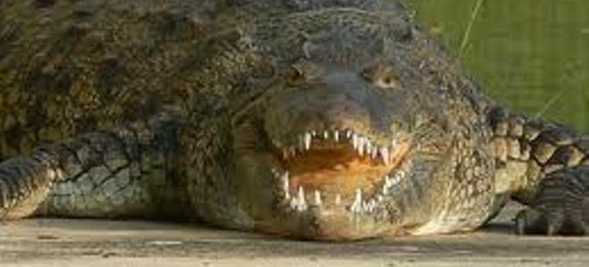
Interesting Facts
The island is one of the leading banana exporters in the Caribbean, with six different varieties available.
St Lucia has won no Olympic medals. Its largest team was six athletes at Atlanta 1996
The national bird is the St Lucia Parrot, or Jacquot, which is native only to Saint Lucia
Population of St. Lucia is 180,870 (est. 2012)

Slide 9
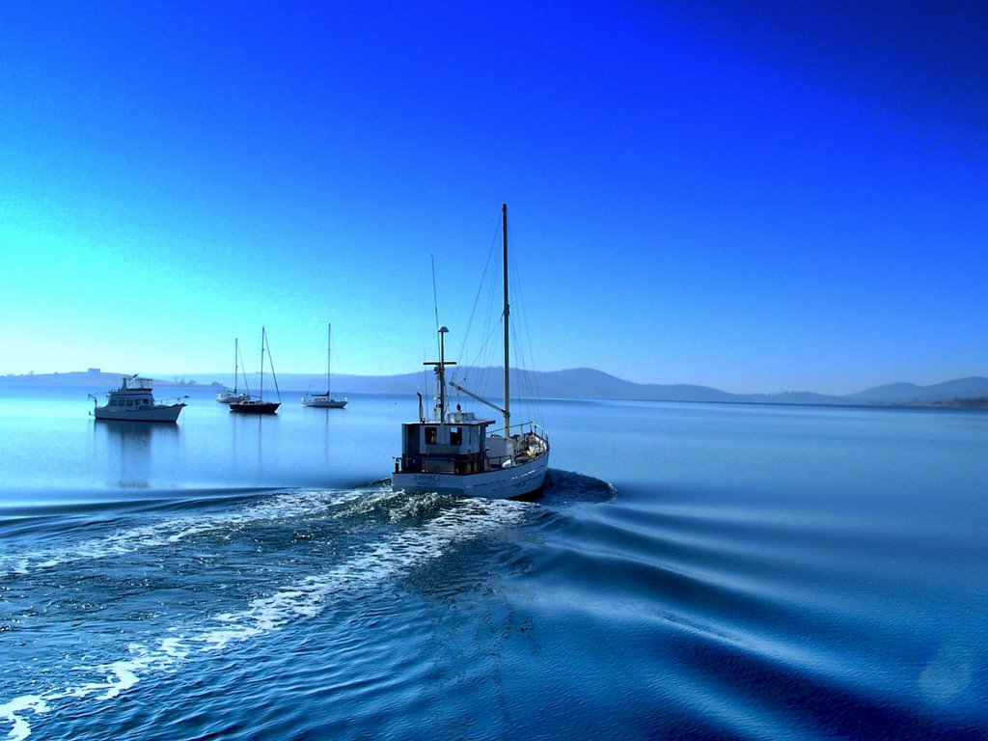
Questions for the end.
What is the one thing St. Lucia exports the most?
Who ruled St. Lucia before independence?
Where is St. Lucia located? (Lesser Antilles, Greater, Bahamas)
What is the major physical feature in St. Lucia?
Background is boat…leaving…go.

Slide 10
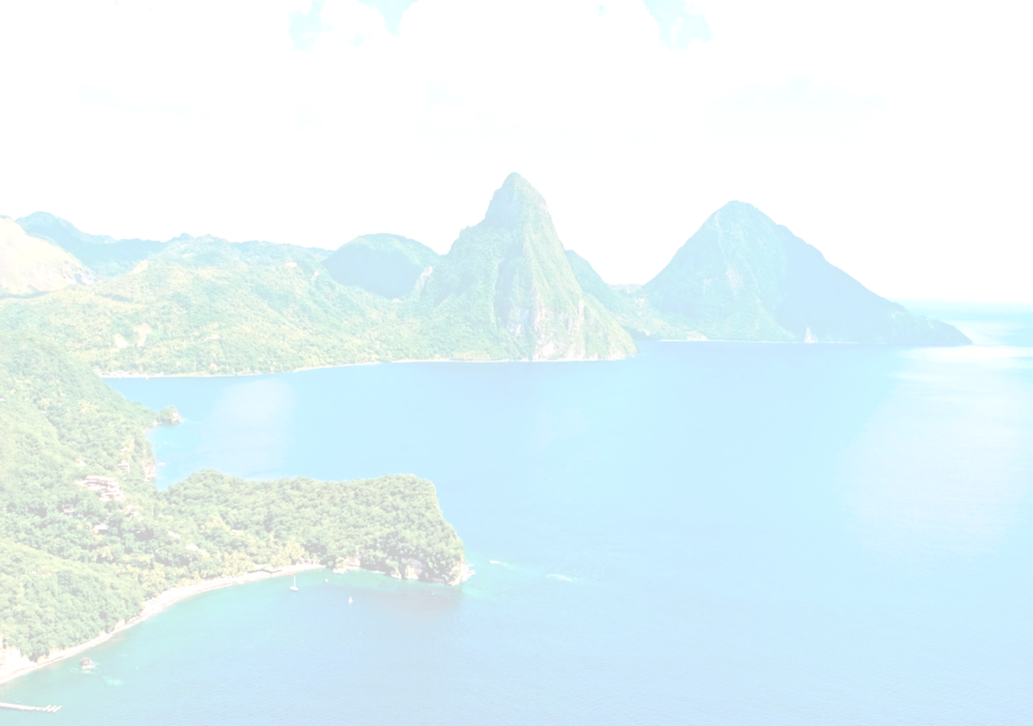
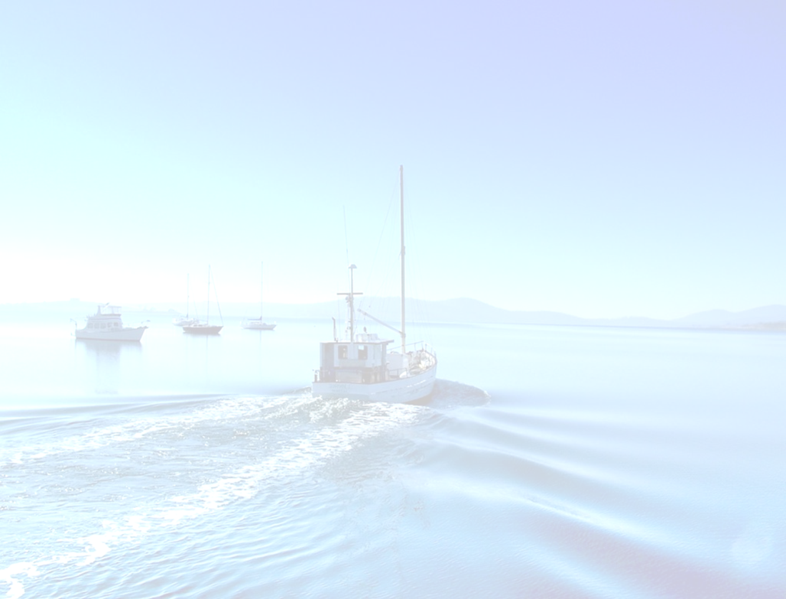
We come to the end…
As we come to the end we learn so much about one of the most beautiful countries in the Caribbean's, culturally and physically. St. Lucia is filled with lush greenery and beautiful mountain views. It is a place to go for some peace and some fun with the family.

Slide 11
Sources……
"Geography." Infoplease. Infoplease, n.d. Web. 19 Mar. 2014.
Central Intelligence Agency. Central Intelligence Agency, n.d. Web. 17 Mar. 2014
"Geography and Map of Saint Lucia." Geography and Map of Saint Lucia. N.p., n.d. Web. 19 Mar. 2014.
"Top 10 Facts about Saint Lucia." Daily Express Top 10 Facts RSS. N.p., n.d. Web. 19 Mar. 2014.

