Slide 1
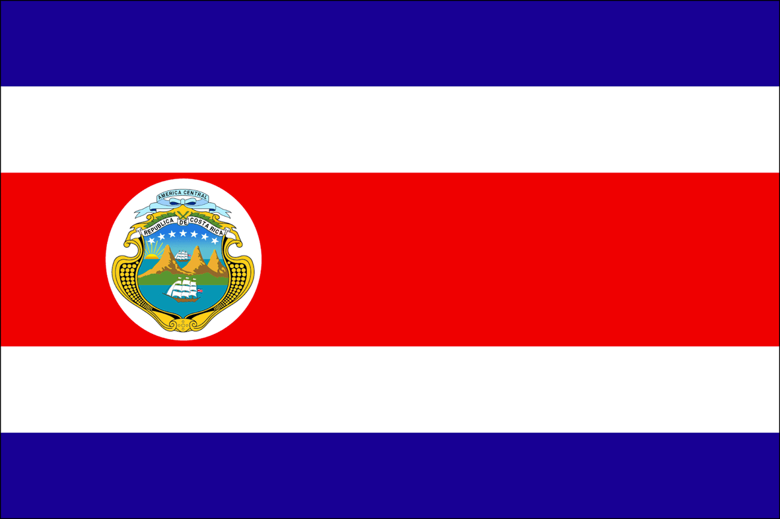
Costa Rica
Freddy Noguera
P.7th
^{3/19/2014}

Slide 2
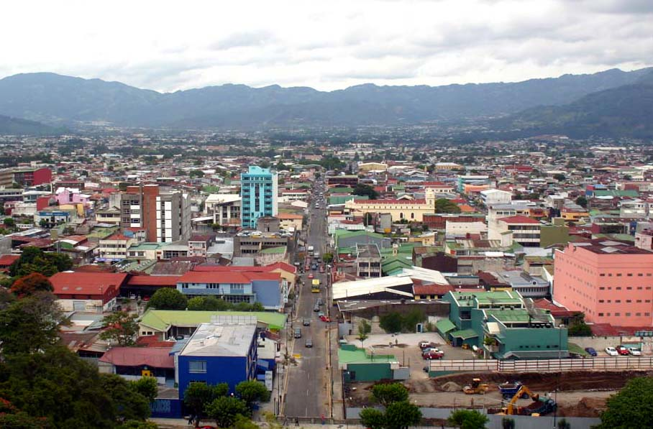
Introduction
Costa Rica
San José is the capital of Costa Rica
The major language spoken in Costa Rica is Spanish
Costa Rica is located in the continent of North America

Slide 3
History
September 15, 1821 is the date Costa Rica came into existence
President of Costa Rica is Laura Chinchilla.
Major events that occurred in the country is when Laura Chinchilla became the first women to become president in the country’s history. Also, in 1821 is when Costa Rica gained its independence.
Costa Rica became a country when they declared their independence from Spain in 15 of September 1821.

Slide 4
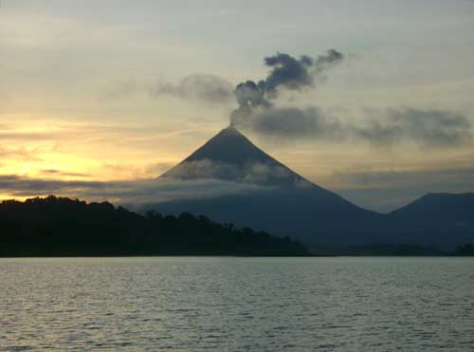
Geography
A major landform in Costa Rica is the Sierra Madre that dominates most of the country’s land. Also, the active volcano called Arenal Volcano. Cerro Chirripo is the highest point in Costa Rica.
A major landmark in Costa Rica is the active volcano called Arenal Volcano.
Major body of waters located in Costa Rica is the Pacific and the Caribbean Sea. The San Juan River, Sierpe River, Sarapique River are some of the rivers located in the country of Costa Rica.
Major cities in Costa Rica is San Jose, Limon, San Francisco, and Liberia.

Slide 5
Culture
Costa Rica is a Democratic Republic and most of the population in Costa Rica is Roman Catholic. Many of the holidays observed in Costa Rica is their independence day in which takes place on September 15. Another holiday that is observed in Costa Rica is Annexation of Guanacaste which is observed on July 15.

Slide 6
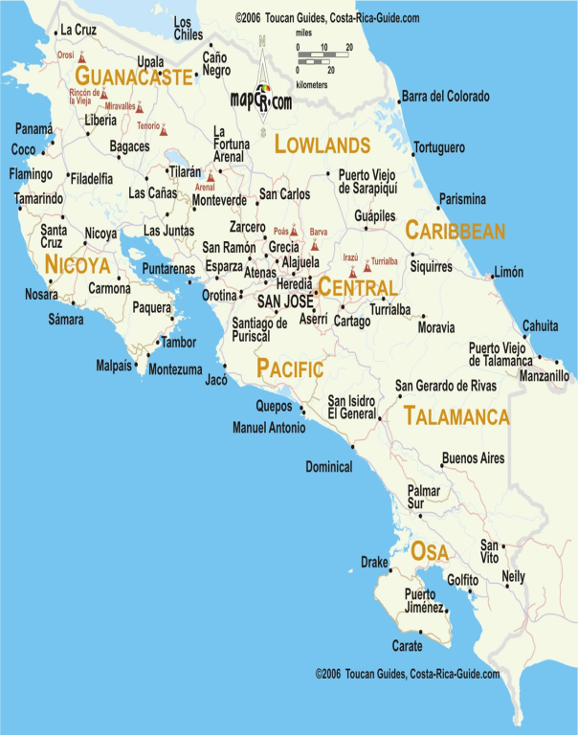
Economy
The GDP in Costa Rica is 45.13 billion in 2012. The currency in Costa Rica is the Costa Rican colón. The manufacturing area in Costa Rica is mostly in the country’s capital San Jose. The land use in Costa Rica is arable land: 4%; permanent crops: 6%; other: 90% and others could be mostly manufacturing.
Map of Costa Rica

Slide 7
Climate
Costa Rica has a temperate tropical climate marked by two seasons: the dry (December-April) and the wet (May-November). Average Temperature in Costa Rica is between 71 and 81 degrees Fahrenheit. Average rainfall in Costa Rica is more than 200 inches yearly.

Slide 8
Interesting Facts
About 4.805 million people live in Costa Rica. One animal that is native to Costa Rica is the Strawberry Poison Dart Frog which is in no danger of being extinct in the country. Modes of transportation in Costa Rica are Shuttle Buses, Buses, Car, and Domestic Flights. Even though Costa Rica is the about the size of West Virginia, its mountainous terrain and dangerous roads make it easier to travel on plane than traveling on car which traveling on car could actually take at an average of 8 hours while traveling on plane could short the trip down to 35 minutes.

Slide 9
Conclusion
In conclusion, Costa Rica is a very beautiful country which in fact Costa Rica is Spanish for Rich Coast. It’s the most politically stable country in Central America and been like that for many years. Being located near the equator, it has many beautiful rainforest which tourists can visit and experience the country’s natural environment. Costa Rica is a country that everyone should visit!

Slide 10
Questions
What is Costa Rica’s currency?
What year did Costa Rica gain its independence?
What is Costa Rica’s GDP?
Who is the current president of Costa Rica?

