Slide 1
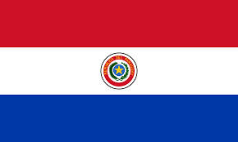
Paraguay, Asuncion
By: Denise Zamora

Slide 2
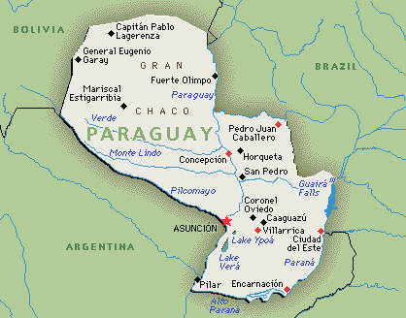
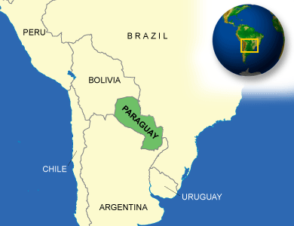

Slide 3
History
Indians speaking Guaraní is the most common language in Paraguay today, after the Spanish there were the country's first inhabitants. In 1526 and again in 1529, Sebastian Cabot explored Paraguay when he sailed up the Paraná and Paraguay rivers. From 1608 until their expulsion from the Spanish dominions in 1767, the Jesuits maintained an extensive establishment in the south and east of Paraguay. In 1811, Paraguay revolted against Spanish rule and became a nominal republic under two consuls.
Paraguay was governed by three dictators during the first 60 years of independence. A new constitution in 1870, designed to prevent dictatorships and internal strife, failed to do so, and not until 1912 did a period of comparative economic and political stability begin. The Chaco War (1932–1935) with Bolivia won Paraguay more western territory.

Slide 4
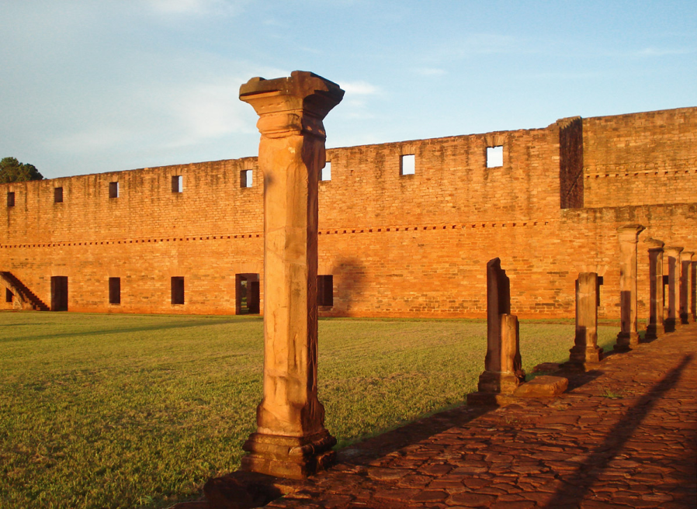
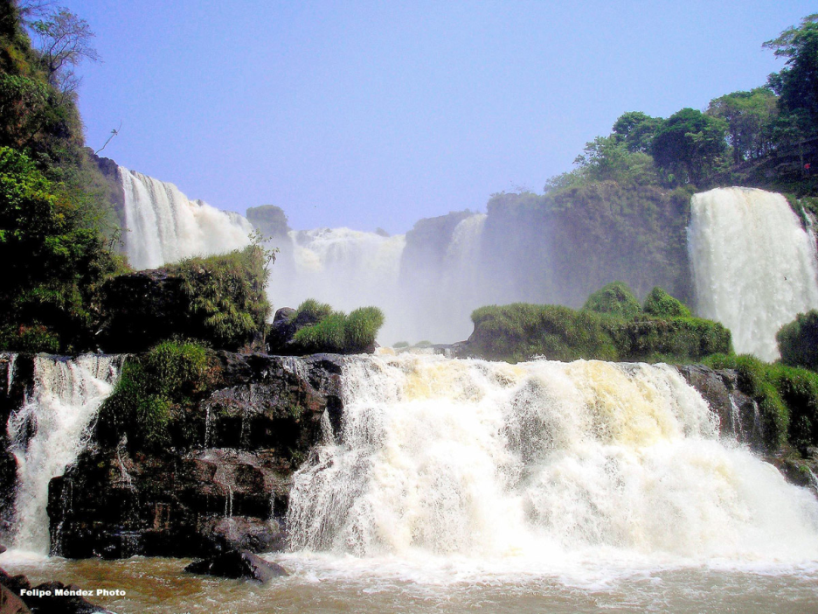
Geography
Paraguay is landlocked by several countries, a few of them are: Brazil, Bolivia, and Argentina
Eastern Paraguay, is known to have the thickest population settled on the grassy slope that inclines toward the Paraguay River. The greater part of the Chaco region to the west is covered with marshes, lagoons, dense forests, and jungles.

Slide 5
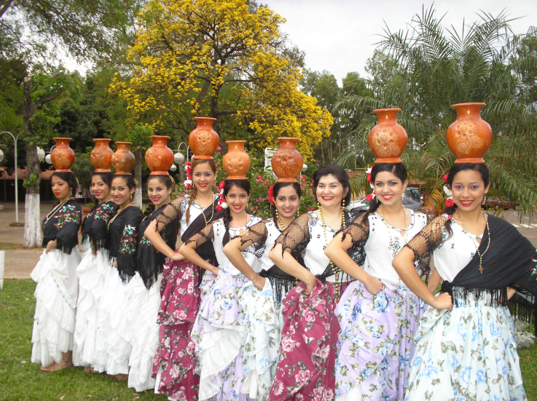
Culture
"Paraguay" derives from the river that divides the eastern half of the nation from the western Chaco region. The vast majority of the population (95 percent) shares a Paraguayan identity, but several other cultural identities exist. The indigenous population is composed of seventeen ethnic groups from five linguistic families. Most immigrants have blended into the national population, but several groups have maintained distinct identities and cultures. Those groups include Mennonites, who settled in the western (Chaco) and the northern regions early in the early twentieth century; Japanese, who settled in agricultural colonies primarily during the 1950s and 1960s; and more recent Korean, Lebanese, and ethnic Chinese immigrants, who have settled in the urban centers of Asunción and Ciudad del Este since the 1970s. In the 1960s and 1970s, large numbers of Brazilian immigrant farmers moved to the eastern frontier region and became the backbone of the soybean export sector.

Slide 6
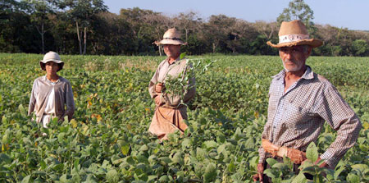
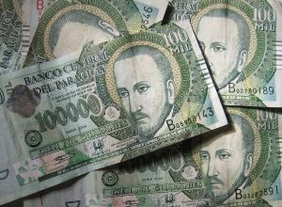
Economy
Paraguay has a market economy characterized by a large informal sector. Agriculture dominates the economy, but unequal land distribution has resulted in a large class of peasant farm laborers. A large portion of the population is uninvolved in the formal economy, instead existing as subsistence farmers. In recent years, the economy has grown as a result of increased agricultural exports, especially soybeans.

Slide 7
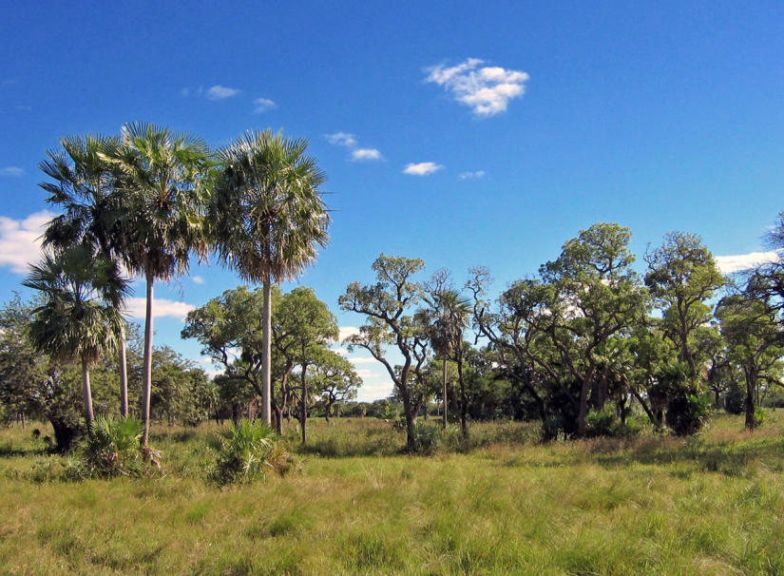
Climate
Paraguay enjoys a climate that varies from temperate to hot during the majority of the year, with an average temperature of 75 degrees Fahrenheit. The Eastern Region enjoys a more humid and rainy climate; the Western Region is arid and dry.
Summers are long, with temperatures that reach 105 degrees on peak days; winters are mild and short, albeit in the months of July and August, some days the temperature can dip down to 0 degrees centigrade.

Slide 8
Interesting facts
The largest city and capital is Asuncion with 0.5 million people, followed by Ciudad del Este, San Lorenzo, Luque, Capiata, Lambare, Fernando de la Mora, Limpio, Nemby, and Encarnacion.
The currency used is the Paraguay Guarani, PYG. Major industries include agriculture and cattle ranching, with Paraguay being the 3rd largest soybean exporter worldwide.
Terere is the national drink of Paraguay, a unique tea blend that includes fruit, sweeteners, and herbs.
There are about 500,000 people that visit Paraguay every year.

Slide 9
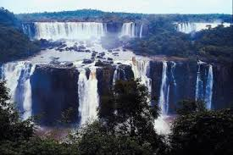
Conclusion
Overall Paraguay is a country that is land locked by Brazil, Bolivia, and Argentina. The country is a market economy, and it is known to be the world’s main exporter of soy beans. Religion in Paraguay, it outlines the important role of the Catholic Church in the cultural history of the country. Ninety-two percent of the population professes to be Catholic. In my opinion, I think that Paraguay is a very interesting county due to the fact that it is filled with so many different types of ethnicity groups, and it is so diverse in culture. Paraguay itself seems incredibly beautiful, and the majority of people in Paraguay are crazy about soccer.

Slide 10
Questions
In what year was Paraguay first founded? And by which country or countries?
Which three countries land lock Paraguay?
What is the capital of Paraguay?
What’s the population in Paraguay?

