Slide 1
Haiti
Chelsey Perry 7th Honors Geography, 3-19-14

Slide 2
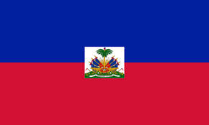
Introduction…
Name : Haiti
Capital : Port-au-Prince
Major languages spoken : French (official), Creole (official)
Location : The Caribbean
Haiti's flag

Slide 3
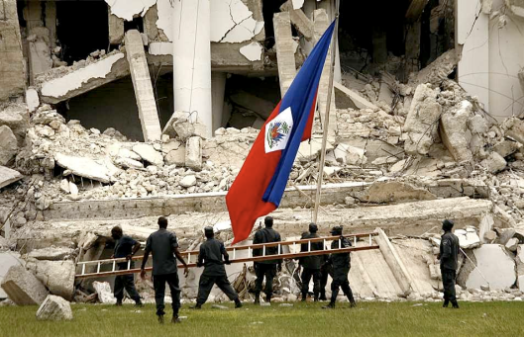
The History of Haiti…
When Haiti was discovered:1492
Important people of Haiti’s history: Jean Jacques Dessalines(gave Haiti its name after making it independent , became “emperor but was overthrown), Christopher Columbus ( “discovered Haiti”), Toussaint-Louverture (Started Haitian revolution against the French), Michel Martelly(Todays Haitian president of Haiti.)
Major Events: Discovery of Haiti (1492) , Independence day(1804-01-01) , Haitian revolution (1791) , 7.0 Earthquake in Haiti ( Jan. 12, 2010)
How did Haiti become a country?: Against Napoléon Bonaparte , Pierre-Dominique Toussaint l'Ouverture declared Haiti’s Independence in 1801. Haiti was able to reach this achievement because a massive slave revolution took place demanding that Haiti become it’s own country instead of being ruled by the French. Jean Jacques Dessalines became their leader once Napoléons troops were pushed away.
Ruins of the Haitian earthquake

Slide 4
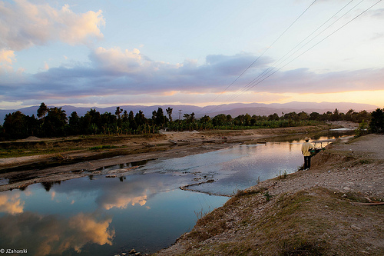
Geography…
Major Landforms: Pic La Stelle in the Massif De La Selle Mtns, Artibonite Plains , and La Gonave Island
Major landmarks:Citadelle Laferriè in Cap-Haitien, Iron Market in Port-au-Prince , Bassin Bleue in Jacme
Major bodies of water: (Rivers )Artibonite, Rivière de la Grand’Anse, Rivière de Cavaillon ,Rivière Momance ,Rivière du Limbe. (Lakes) Lake Azuei , Lake of Miragoane, Trou Caiman
Major cities: Port-au-Prince (Capital ),Carrefour(second largest city)
River Atribonite in Haiti

Slide 5
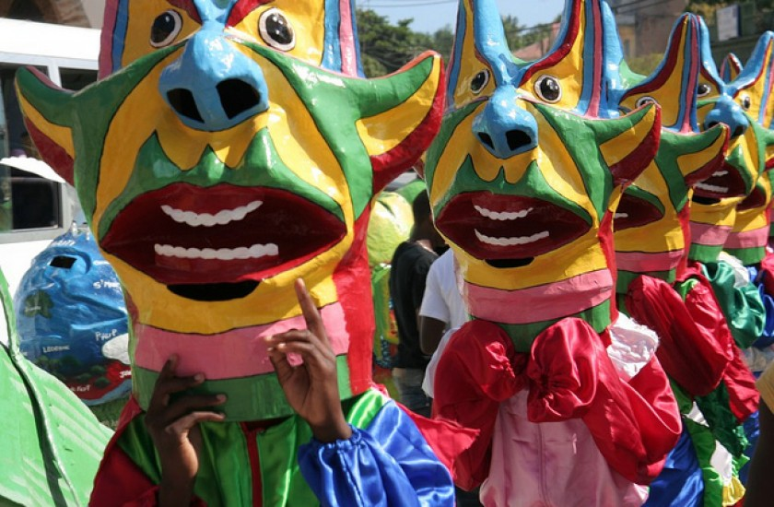
CULTURE…
Clothing: Most people wear lightweight clothing the U.S. is Haiti’s main importer of clothing , so the clothing is westernized with American brands.
Music: The traditional music of Haiti is influenced mostly by European countries such as France . For example, the French “Merengue”. Additional music derives from countries all over the world such as hip hop and pop music.
Major holidays: Independence day (January 1st), Ancestors day (January 2nd , special parades are held to honor ancestors.) ,Carnival(month of February a celebration leading up to Mardi Gras), Easter ,and Christmas.
Religions: Roman Catholic 80%, Protestant 16% , none 1%, other 3%(about half of the country practices voodoo.)
Food: Haiti’s foods are European influenced . For example French cheeses, desserts, and breads. Also , okra(for gumbo) , and meals such as red beans and rice. are common .
Government: Haiti’s gov’t is a Republic. Their president is Michel Martelly (since May 14 2011) The head of government is the Prime Minister, Laurent Lamothe (since May 16 2012)
Carnival in Haiti 2014 parade

Slide 6
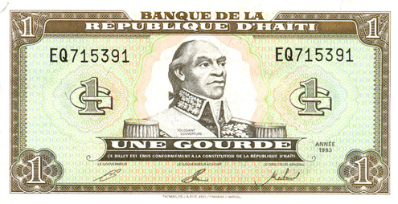
Economy…
Natural Resources: (petroleum , fuel)oils, cocoa, mangoes, coffee , industrial manufacturing, sugar ,bauxite, copper, calcium carbonate, gold, marble, and hydropower
Manufacturing areas: Agriculture, forestry, and fishing
Land use :36.04% arable (land replanted after each harvest), permanent crops10.09% ( land cultivated for crops that are not replanted after each harvest.), and other 53.87% (any land not arable or under permanent crops.)
Major jobs: Major jobs are found in services and agriculture.
Currency: Haitian gourde ,1.00 USD=39.4000 HTG
Haitian Gourde:

Slide 7
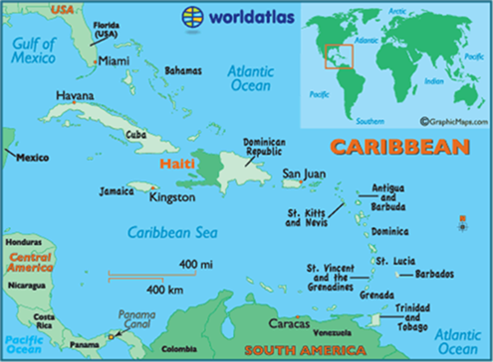
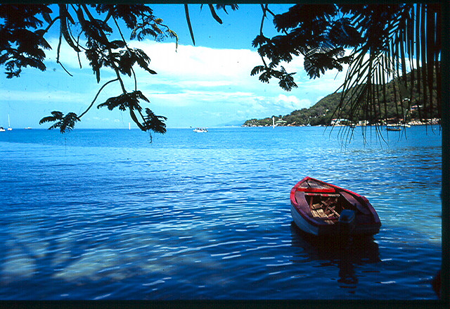
Climate…
General weather conditions: tropical , semi-arid ( very humid at times)
Average yearly rainfall:137 cm (54 in)
Average yearly temperature:(77–95° F)
What effects the climate has on the country: Haiti has periodic droughts and floods, made more severe by deforestation. Hurricanes are also a problem because of the humidity.
Tropical climate
MAP OF HAITI

Slide 8
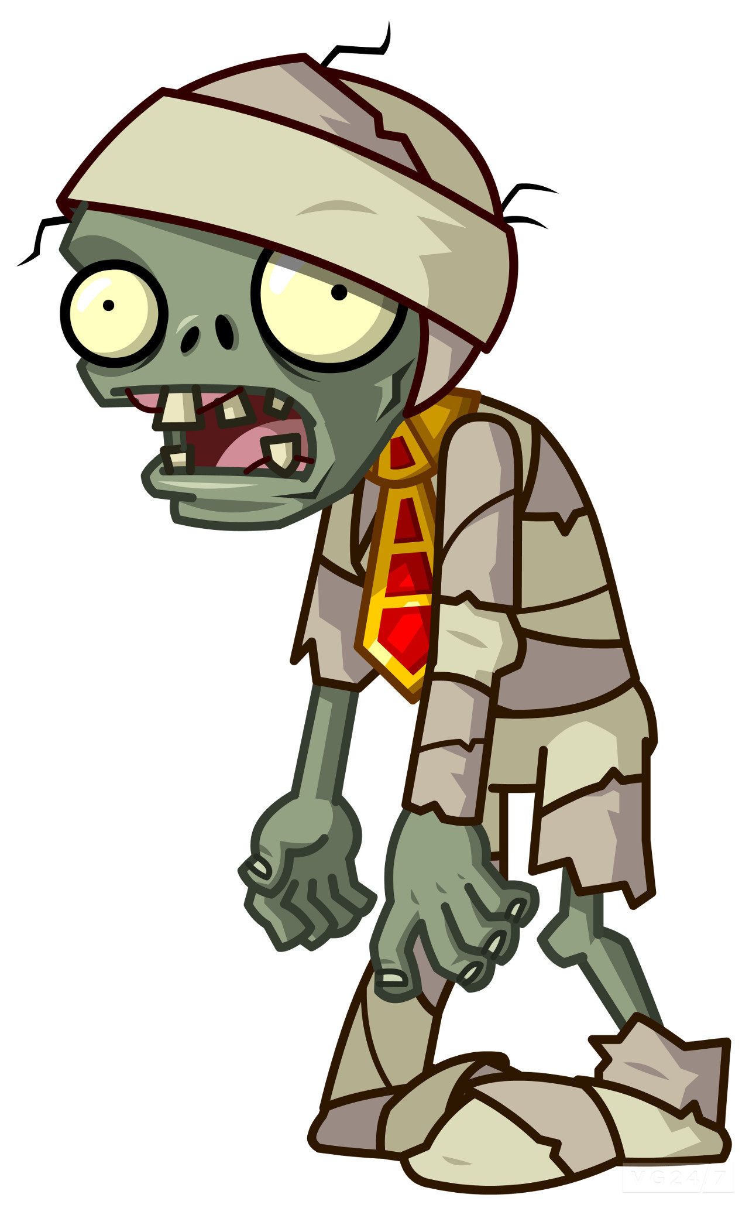
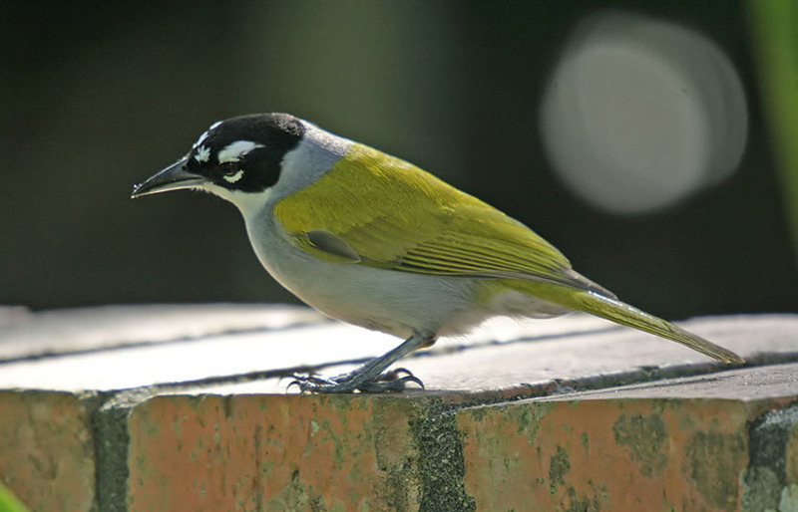
Interesting facts…
Population:9,996,731
Modes of Transportation: The main transportation consists of cars, walking on foot or airports.
Story behind the flag: The flag of Haiti has two horizontal bars, blue over red, in front of a white panel bearing the Haitian coat of arms. The coat of arms represents a trophy of weapons ready to defend freedom and a royal palm for independence. The palm is topped by the Cap of Liberty.
Strange laws: it is illegal to create zombies , it is illegal to buy a mattress on Sunday.
Travel tips : Sign up for the Smart Traveler Enrollment Program to stay in touch with the US government, make copies of your passport , don’t keep valuable items in one place , when in a hotel keep valuable items in the hotel safe , keep up with local laws and customs , and avoid travelling alone.
Native animals: Gray-crowned Palm Tanager(bird), Mozart, 'Ventriloquist‘(frog) , several bat species are native to only Haiti.(many animals that are native to Haiti have become extinct due to deforestation.)
zombie
Gray-Crowned Palm Tanager

Slide 9
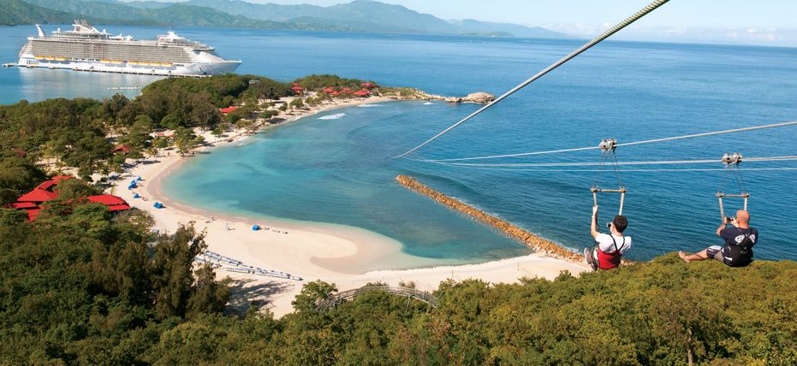
Conclusion…
All in all , the beautiful country of Haiti may have its faults in economics, but it is full of various cultures and beautiful sites to see. Haiti has an interesting and insightful history along with many different types of music, dance, religions ,and foods to eat . If you ever wish to visit Haiti , pay attention to safety precautions and the trip will be well worth the visit.
Haiti zip line

Slide 10
Bibliography…
https://www.cia.gov/library/publications/the-world-factbook/geos/ha.html
http://www.aaregistry.org/historic_events/view/independence-haiti
http://www.history.com/this-day-in-history/haitian-independence-proclaimed
http://www.worldatlas.com/webimage/countrys/namerica/caribb/haiti/htland.htm
http://traveltips.usatoday.com/main-landforms-haiti-102655.html
http://www.hougansydney.com/landmarks-of-haiti.php
http://www.uhhp.com/haiti/lake_rivers.html
http://www.ask.com/question/haitian-clothing
http://tiger.towson.edu/~cdesti1/haiti%20music.html
http://www.everyculture.com/wc/Germany-to-Jamaica/Haitians.html
: http://www.foodbycountry.com/Germany-to-Japan/Haiti.html#ixzz2wLVy5Jqe
http://www.britannica.com/EBchecked/topic/251961/Haiti/54468/Agriculture-forestry-and-fishing
http://www.indexmundi.com/haiti/land_use.html
http://www.nationsencyclopedia.com/Americas/Haiti-CLIMATE.html

Slide 11
4 questions about Haiti…
What are the major languages spoken in Haiti?
What are two holidays that Haiti has in common with the US?
What type of Government does Haiti have?
What has caused most of Haiti’s native animals to become extinct?

