Slide 1
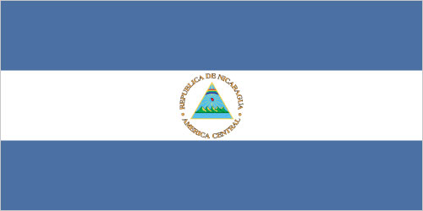
Nicaragua
By: Brandon Turner 7th

Slide 2
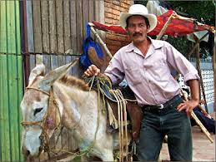
Introduction
Country: Nicaragua
Capital: Managua
Major Languages: Spanish
Location: Central America (North America)

Slide 3
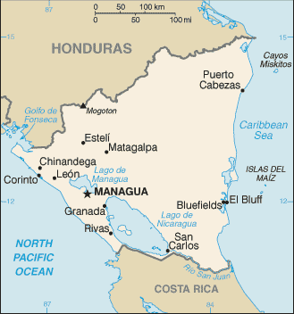
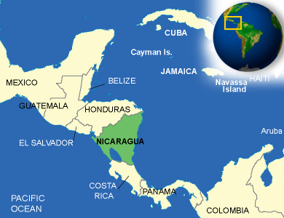
Map

Slide 4
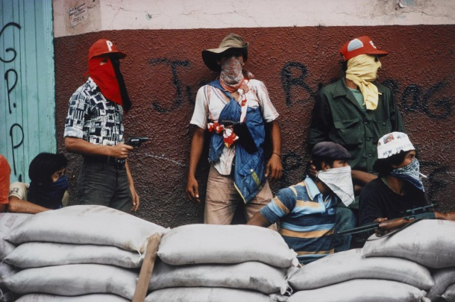
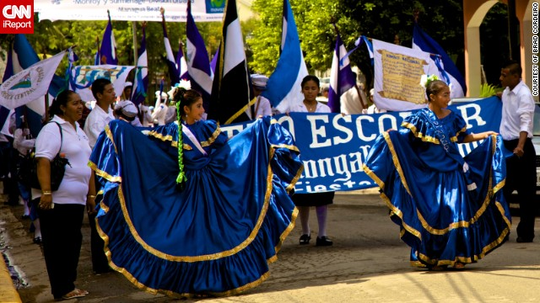
History
Gained independence from Spain in 1821.
Became an independent republic in 1838.
In 1978 a short-lived civil war by the Marxist Sandinista guerrillas and took power in 1979.
They lost free elections in 1990, 1996, and 2001.
They got it back and elected Daniel Ortega Saavedra in 2006 and again in 2011.

Slide 5
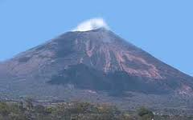
Geography
Major landforms: Isabelia Mountains, Volcano Row, Masaya Volcano.
Major landmarks: Leon Cathedral, Chocoyero el brujo natural reserve, Laguna de apoyo
Major bodies of water: Lago de Nicaragua, Pacific Ocean, Caribbean Sea, lake Managua, Rio San Juan River, Coco River.
Major cities: Managua(capitol), San Carlos, Leon, Corinto, El Bluff.

Slide 6
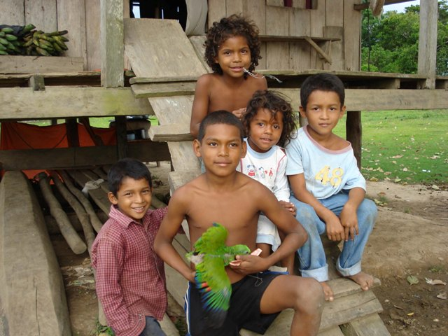
Culture
The culture in Nicaragua is very diverse and unique. The type of clothing they have is very clean loose white shirt and pants. They also usually only have one or two outfits. Also the holidays are just like ours in the U.S. Food in the country dates back to the pre-Colombian times. They eat dishes like Nacatamal, Indio Viejo, and Sopa de Albondiga. Unlike the U.S. their music is a mix of Spanish and European music. The religion in this country is mostly Roman Catholic and Protestant. Another fact about the culture in Nicaragua is that they have a republic.

Slide 7
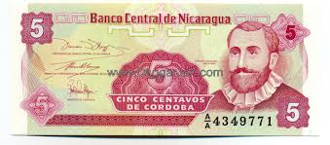
Economy
Natural Resources: coffee, beef, gold, sugar, peanuts, shrimp and lobster, tobacco, cigars, automobile wiring harnesses, textiles, apparel, cotton.
Manufacturing areas: There are not many manufacturing areas and the ones they have are small and are located at the capital.
Land use: agriculture: 28%, industry: 19%, services: 53%.
Major occupations: agriculture and farming.
Currency: Nicaraguan córdoba.

Slide 8
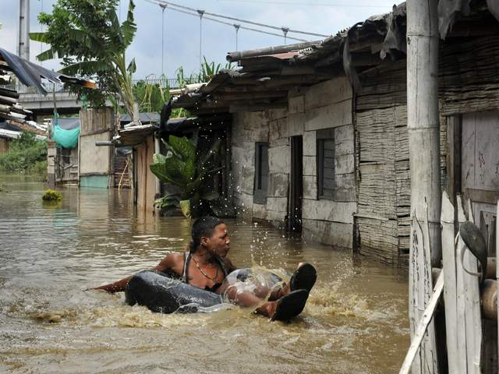
Climate
Weather conditions: Very warm year round and lots of rain that can cause extreme floods.
Average yearly rainfall: 103.3in. a year.
Average yearly temperature: The low is 74.8 ̊ F and the high is 85.5 ̊ F.
Effects of climate: The climate is good for growing tropical crops ,but the floods and ruin these crops.

Slide 9
Interesting Facts
Population: 5,848,641
Nicaragua is also known as the 2nd poorest country in the western hemisphere.
Nicaragua is the largest country in central America.
There baseball team took 2nd in the 1996 Olympics in Atlanta.
Nicaragua had the first elected woman president of any central America country.
Independence Day: 15 September 1821

Slide 10
Conclusion
Nicaragua is a very interesting country. Its culture and people are unique in its very own way. This country’s History, Geography, Culture, Economy, Climate are like none other throughout the whole entire world.

Slide 11
Questions
What is the major language spoken in Nicaragua?
What currency is used here?
What is the largest lake in Nicaragua?
What literacy rate would you expect this country to have?

Slide 12
Work Cited
https://www.cia.gov/library/publications/the-world-factbook/geos/nu.html
http://www.nationsencyclopedia.com/economies/Americas/Nicaragua.html
http://www.britannica.com/EBchecked/topic/413855/Nicaragua/40978/Agriculture-forestry-and-fishing
http://hikingjoy101.com/18-entertaining-interesting-facts-about-nicaragua/

