Slide 1
BELIZE
Luzmaria Andia
3/19/14
7th period

Slide 2
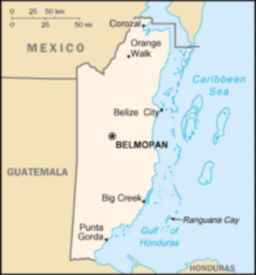
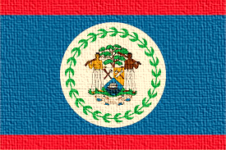
INTRO
Name of my country is Belize
Capital of my country is Belmopan
Major languages spoken: English(official), Spanish
Location of country is south of Mexico and east and north of Guatemala in Central America

Slide 3
HISTORY
Belize came into existence around 1000 B.C
George Cadle Price first prime minister, “father of the nation,” Dame Elmira Minita Gordon first woman governor-general, Manuel Esquivel political leader, Ncholas Pollard, Sr. politician, trade union leader, Prime Minister Said Musa
(1636) Major war between Maya and Spanish occurred, (1642) War for Belize ended, gained independence, (1981) Belize became independent from Britain

Slide 4
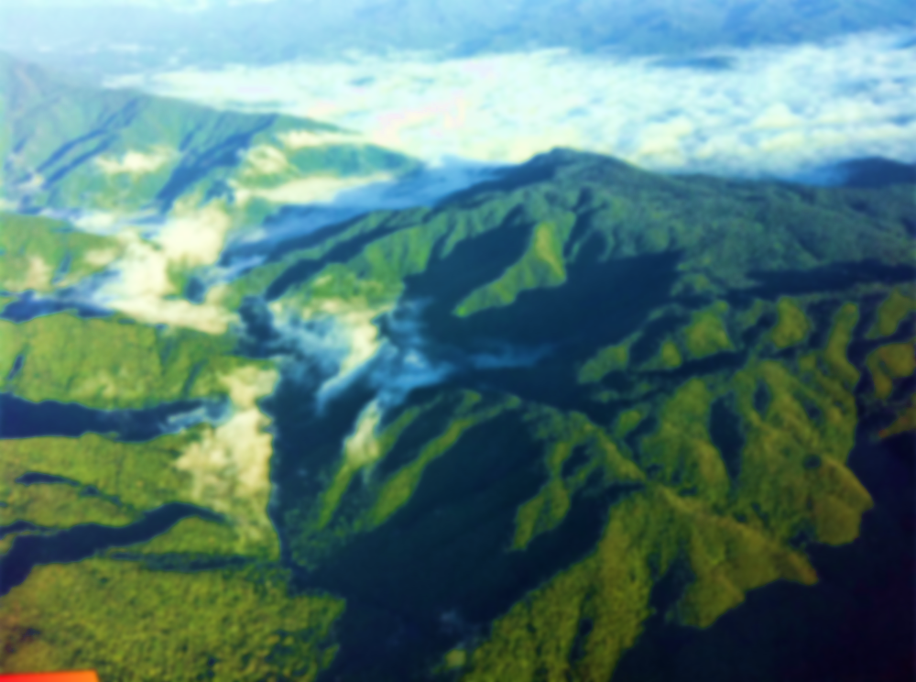
GEOGRAPHY
The Maya mountains, the highest point is the Victoria Peak in the Cockscomb Range, The Blue Hole, Yucatan peninsula, The Rio Hondo, "Maya Heartland," The Belize Barrier Reef
Major cities: Belize City, San Ignacio, Orange Walk, Belmopan

Slide 5
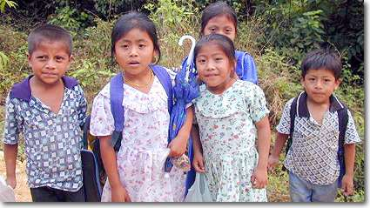
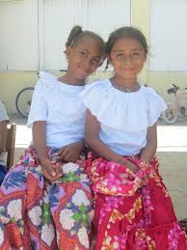
CULTURE
Men wear Euro-American style pants/shirts. Women wear plain color, full-length dresses sewn from a variety of bright color material. On the 1st & 2nd of November-All Saint's Day and All Souls Day &The Feast of San Luis is celebrated during Easter. Imported bleached wheat flour, corn, beans, rice, & poultry are the common foods. Religion: (62%)Roman Catholics, (28%) Protestants. Government: Parliamentary Democracy & a Commonwealth realm. Music: a mix of Kriol, Mestizo, Garifuna, and Maya influences.

Slide 6
ECONOMY
Natural resources: arable land potential, timber, fish, hydropower
Currency: Belizean Dollar (BZD)
Land use: arable land: 3.05%
permanent crops: 1.39%
other: 95.56% (2005)

Slide 7
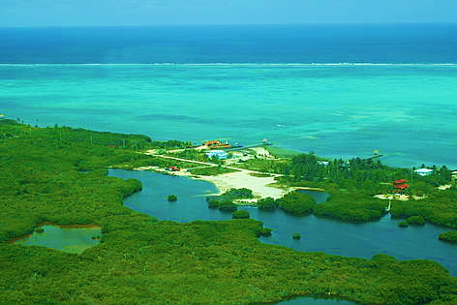
CLIMATE
Consistently warm and humid tropical weather, sub-tropical, with pronounced wet and dry seasons.
Rainfall varies from an average of 1,295 millimeters in the north to 4,445 millimeters in the extreme south.
Temperatures in coastal districts range from about 10*C (50*F) to about 35.6*C (96*F); inland the range is greater.
Belize is occasionally the victim of the Atlantic Ocean hurricane season.

Slide 8
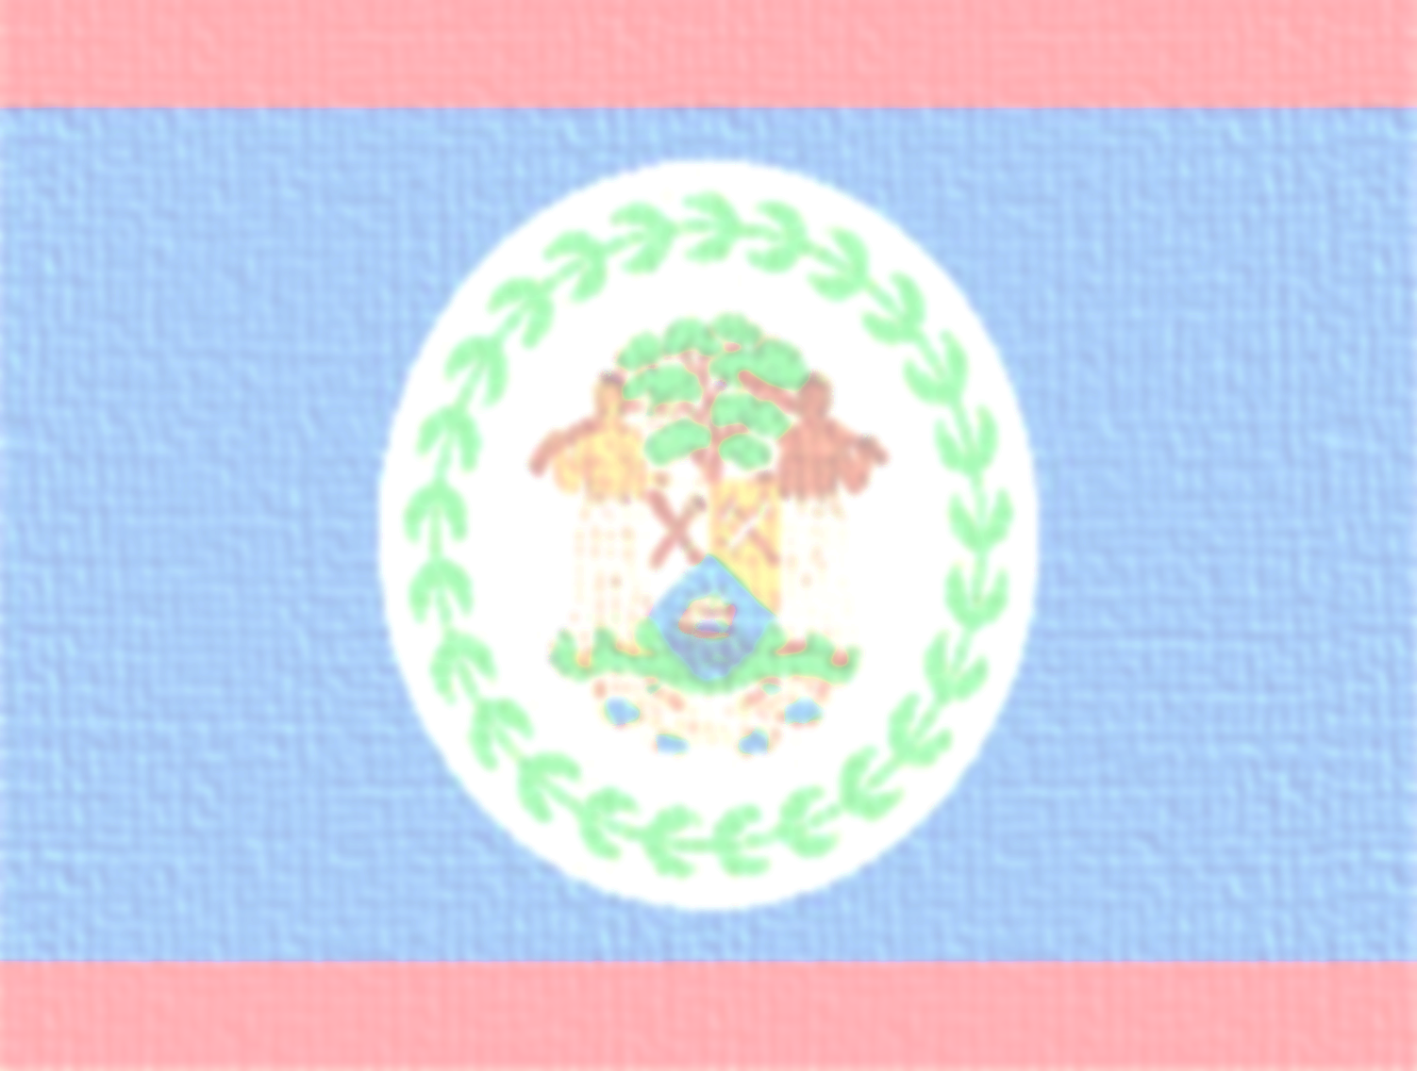
INTERESTING FACTS
Population 340,844 (July 2014 est.)
The blue is the party color of the PUP, while the red stripes were added to recognize the color of the opposition party. The centered coat of arm features 50 leaves, symbolizing the year the (People's United Party) came into power.
Transportation: airports, roadways, water ways, ports & terminals
The time to travel is November to late April because during this time the weather is subtropical.
Native animals: armadillos, snakes, and monkeys

Slide 9
CONCULSION
Overall, I have learned that Belize has a very diverse society; with many cultures, languages and ethnic groups. It is a very beautiful country with many natural attractions. In my opinion, Belize is very gorgeous with its variety of wildlife. Belize is truly unique and different from any country in Central America.

Slide 10
Questions
What is the official language?
What is one of the major cities?
What are the two major religions?
What is one common food in Belize?

Slide 11
http://www.worldatlas.com/webimage/countrys/camerica.htm
https://www.cia.gov/library/publications/the-world-factbook/geos/bh.html
http://ambergriscaye.com/pages/town/factsbze.html
http://www.southernbelize.com/hist_mayan.html
http://www.adventure-life.com/articles/belize-history-906/
http://www.mongabay.com/history/belize/belize-manufacturing.html

