Slide 1
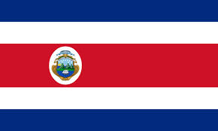
Costa Rica
By: Armiah Ferguson

Slide 2
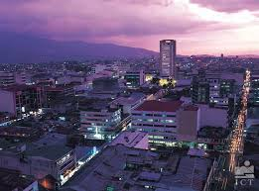
Capital of Costa Rica ?
The capital of Costa Rica is San Jose.

Slide 3
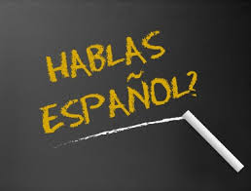
Major Language Spoken In C.R
The official language spoken in Costa Rica is Spanish.

Slide 4
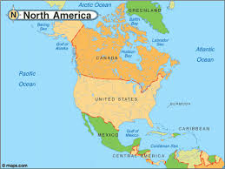
What Continent ?
Costa Rica is located in North America.

Slide 5
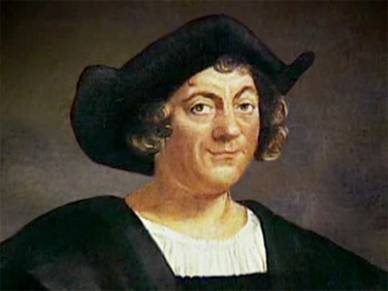
When Was Costa Rica founded ?
The first person to come across Costa Rica was the great navigator Christopher Columbus. This was on September 18, 1502.

Slide 6
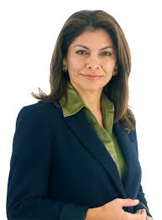
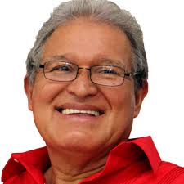
Important People in Costa Rica
Laura Chinchilla is the president of Costa Rica and has been in office since May 8th, 2010. She is the first female president in Costa Rica. President Chinchilla started out as Vice President, and she finally made her way to president of Costa Rica.
The Vice President of Costa Rica is Salvador Sánchez Cerén. He is a former guerilla commander. Vice president Salvador has promised to expand welfare programs.

Slide 7
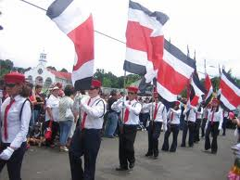
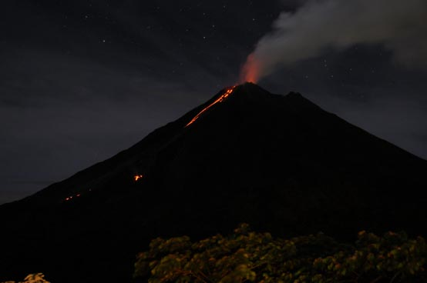
Major Events
In 1821, Costa Rica gained it’s independence from Spain and joined the Mexican Empire
In 1838, Costa Rica became a fully independent country.
In 1968, the Arenal Volcano(a volcano in Costa Rica)

Slide 8
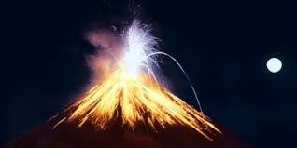
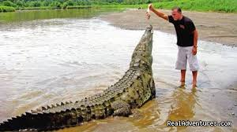
Major Landforms and Rivers
Sierra Madre mountain range (most of Costa Rica is made up of this)
Arenal Volcano
Poas Volcano
Pacuare River (flows into the Carribean Sea)
Reventazon River
Tarcoles River (known for crocodiles)

Slide 9
Major Cities
San Jose (population of 335,007)
El Limon(has some of the prettiest waterfalls)
San Francisco
Havana
Las Tunas

Slide 10
Culture
The culture in Cuba is very diverse. In fact, it is known for its culture diversity. Many Cubans enjoy art, music and literature. Music in Cuba is influenced by the musical styles of countries like Spain, France, and the U.S. Dancing is also a main source of entertainment in Cuba. This is where the Salsa comes from. The main religion in Cuba is Catholic. There is also a lot of poets and writers that get their fame in Cuba.

Slide 11
Important National Holiday in Costa Rica
Independence day is a very important holiday is Costa Rica. It is celebrated by parades and lots of music. It is a happy day for this country(September 15).

Slide 12
Type of Government?
The type of government Costa Rica has is a democracy.

Slide 13
Natural Resources
Costa Rica has few mineral resources but it’s most important natural resources are agricultural land and climate. Others include:
Coffee (known for their coffee beans)
Corn
Bananas
Rice
Squash

Slide 14
Major Occupations
English Teacher
Freelance Writer
Entrepreneur
Real Estate Broker
Farming

Slide 15
Currency
Costa Rica’s currency is Costa Rican colón

Slide 16
Questions
When was Costa Rica founded?
In what year did Costa Rica become fully independent?
What is the official language spoken in Costa Rica?
Who is the current president?

