Slide 1
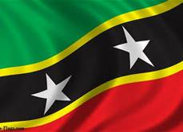
St. Kitts Nevis
Andre Skaling

Slide 2
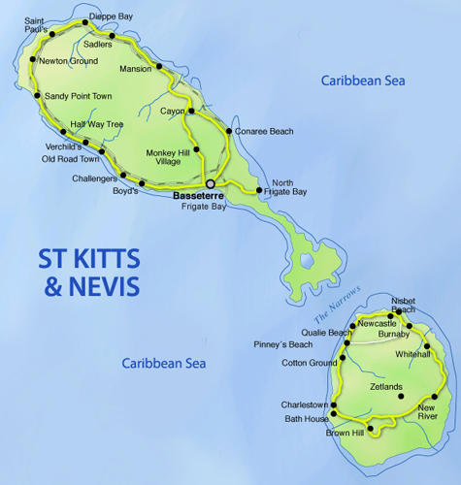
introduction
Honestly, I have never heard of this country before, but maybe you and I will learn a thing or two. The country I’ve been researching is called, “St. Kitts-Nevis” with the capital name of “Basseterre.” The main language is said to be English but most of the population speaks St. Kitts Creole. The country is located in the Leeward Islands which is a federal two-island country in the West Indies.

Slide 3
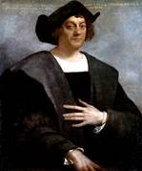
History
This country has so much history, it’s impossible to put all this information in a paragraph. Therefore, I’m going to put this information in one big timeline from the 1400’s-1900’s.
(1493) Christopher Columbus had passed the island on his voyage, but he didn’t land on it. Named St. Kitts after patron saint.
(1623) British established first colony on St. Kitts
(1626) British massacred 2,000 Caribs
(1628) British established colony on Nevis
(1783) Claims to St. Kitts relinquished by France under Treaty of Versailles
(1871) Anguilla united as British dependency
(1932) Center-left Labor Party founded to campaign for independence
(1967) Anguilla became internally self-governing member of West Indies Associated States with Robert Bradshaw, Labor Party leader, prime minister
(1970) Nevis Reformation Party founded
(1971) Anguilla was placed under direct British rule; followed rebellion against domination by St. Kitts

Slide 4
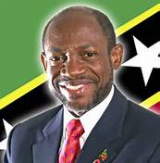
History
(1993) Anti-government demonstrations occurred following general election
(1994) Anti-government riots by Labor Party supporters caused state of emergency to be declared
(1995) Prime Minister Kennedy Simmonds lost in general election; labor party leader Denzil Douglas became prime minister
(1997) Nevis legislators authorized referendum if island should secede from St. Kitts
(1998) St. Kitts and Nevis carried out first execution in 17 years, despite international protests; Hurricane George devastated St. Kitts and Nevis; referendum for Nevis secession failed
(2000) Denzil Douglas won second term as prime minister
(2003) Largest hotel complex in eastern Caribbean opened on Frigate Bay, St. Kitts
(2004) Denzil Douglas won third term as prime minister
(2005) 300-year old sugar industry closed
(2008) Charles Elroy Laplace hanged for murder, government hoped it would serve as deterrent against high levels of violent crimes
(2010) Denzil Douglas won fourth consecutive term as prime minister
(1980) Anguilla granted constitution; union with St. Kitts and Nevis formally revoked
(1983) St. Kitts and Nevis attained independence within British Commonwealth, Kennedy Simmonds prime minister

Slide 5
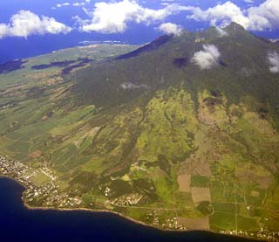
GeoGraphy
Nevis is cone shaped, with a central volcanic peak, Nevis Peak. Mt. Liamuiga, (Formerly known as Mt. Misery) is the tallest volcano (3,792 ft.) in St. Kitts-Nevis. A two story building where Alexander Hamilton lived in, who was born in Nevis in 1757. He only lived on the island until the age of nine, and then moved to St. Croix with his mother. Later in his life, he helped draft the U.S. Constitution and was the first secretary of the Treasury. He was an out spoken advocate of the emancipation of slavery. The building today, known as Hamilton House, houses one of the island's two museums on the first floor. The second floor is the meeting room for the Nevis House of Assembly. The lovely stone building was built around 1680, but was destroyed in an earthquake in 1840, and then restored in 1983. There were ruins called the, Hamilton Ruins, which was a sugar plantation until the Hamilton family owned it in the 1950’s. The islands lie in the Caribbean sea. The major city in St. Kitts is Basseterre, known as the capitol.
Hamilton House
Mount Liamuiga, St. Kitts

Slide 6
Culture
The clothing for men is similar to the clothing men wear here in the U.S. But, clothing for women seems to be the clothing of the 1800’s. Same with the music, the music is also similar to the ones we here on the radio, but music from 2009 is most common. The holidays that are public in St. Kitts-Nevis are New Year's Day. Religions that are in St. Kitts-Nevis are Christianity and Roman Catholic. The government in St. Kitts-Nevis is called Gov★KN and some foods are,
• Spiny lobster. • Crab back. • Roti (thin pastry filled with curried potatoes, chickpeas and beef, chicken, goat, shrimp or vegetables). • Pelau (rice, pigeon peas and meat, similar to paella). • Conch (curried, soused or in salad

Slide 7
Economy
Natural Resources: shiny diamonds,precious stones, silver and gold in open cast mines and off shore oil platforms.
Manufacturing Areas: No Manufacturing currently because of a Hurricane hit in 1998 and 1999.
Land Use: 42% of land is covered for farming.
Major Jobs: Sales Executive.
Currency: East Caribbean dollar.

Slide 8
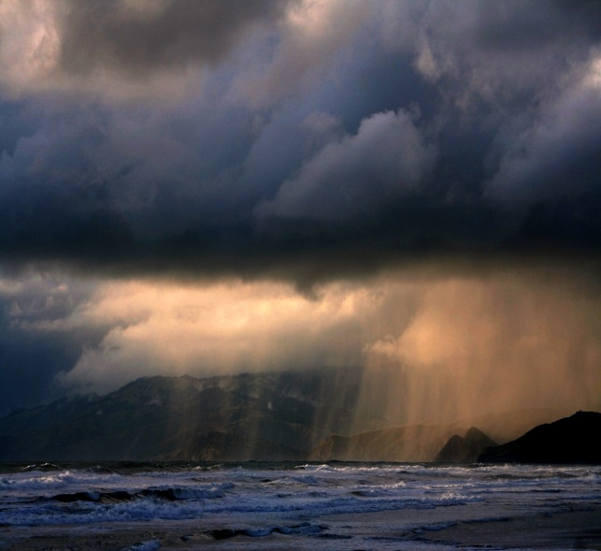
Climate
The most common weather conditions are Sunny and Cloudy. The Yearly Rainfall is about 370m. The Yearly Temperature is about (high) 87 degrees to 75 degrees.

Slide 9
Interesting facts
Population: Around 53,584.
Flag: It is commonly stated that the two stars symbolize the two islands, but in fact they stand for hope and liberty
Modes of Transport: Most Likely Boat and/or Rental Cars/Bikes.
Native Animals : Bat Fauna. Sheep, and Goats

Slide 10
conclusion
A lot more facts can be learned in St. Kitts-Nevis. There really is no end to the History. Can other countries be as interesting as this? That’s for us both to find out.

Slide 11
Q&A
What was the Old Name of the tallest Volcano?
What explorer was first to sight St. Kitts-Nevis?
Who was the Longest Reigning Prime Minister?
The Annual Yearly Rainfall is ____m_?

Slide 12
Bibliography
http://www.stkittstourism.kn/love-st-kitts-culture-history.php
http://www.worldatlas.com/webimage/countrys/namerica/caribb/stkittsandnevis/kntimeln.htm

