Slide 1
St. Kitts and Nevis
By: Adjani Menefee

Slide 2
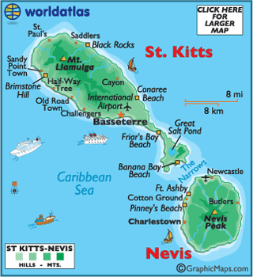
INTRODUCTION
Country- St. Kitts and Nevis
Capital- Basseterre
Major Languages- English (official)
Continent- South America

Slide 3
HISTORY
St. Kitts and Nevis came into existence in 1983
The island territory of Saint Christopher- Nevis- Anguilla was taken over British control. The island of Anguilla rebelled against the British control and gained its independence in 1971. in 1983 the remaining islands gained their independence as Saint Kitts and Nevis
Famous People- Paul Southwell (former chief minister), Sir Clement Arrindell (governor general)
Important Events in History- explored by Christopher Columbus in 1493, inhabited by Carib people, Anglo- French rivalry lasted more than 100 years

Slide 4
GEOGRAPHY
Major Landforms- Mount Liamuiga
Major Landmarks- Frigate Bay, Black Rocks, Independence Square, Bloody Point, Cottle Church
Major Bodies of Water- Great Salt Pond, South Friar’s Bay, The Narrows
Major Cities- Basseterre, Charlestown, Sadlers, Sandy Point

Slide 5
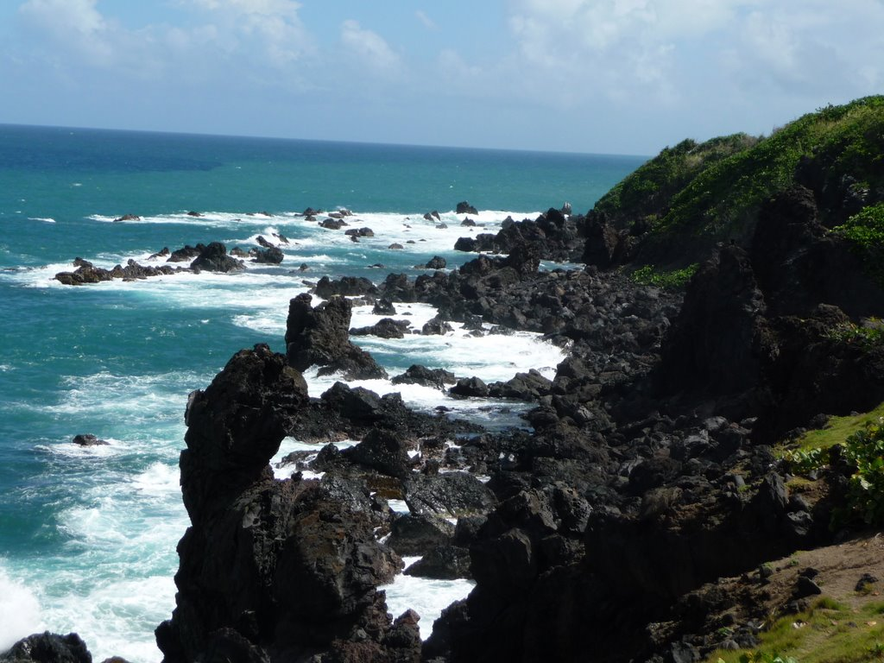
Mount Liamuiga
Black Rocks

Slide 6
CULTURE
Folk music is very popular
Clothing- informal but conservative; skimpy clothing is frowned upon
Government- Constitutional Monarchy
Holidays- New Year (Jan. 1), Carnival Day (Jan. 2), Easter Monday (April 21), National Heroes Day (Sep. 16)
Religions- Christianity (major), Rastafarians
Food- West Indian Cuisine, Pizzerias, Caribbean food, Seafood

Slide 7
ECONOMY
Natural Resources- oil, arable land, the sea
Currency- East Caribbean Dollar
Manufacturing Areas- Mundi
Agriculture is a key area of growth in in national economy
Major Occupations- construction, transportation

Slide 8
climate
General weather conditions- tropical
Average Yearly Temperature- about 72 degrees
Average Yearly Rainfall- about 300 mm

Slide 9
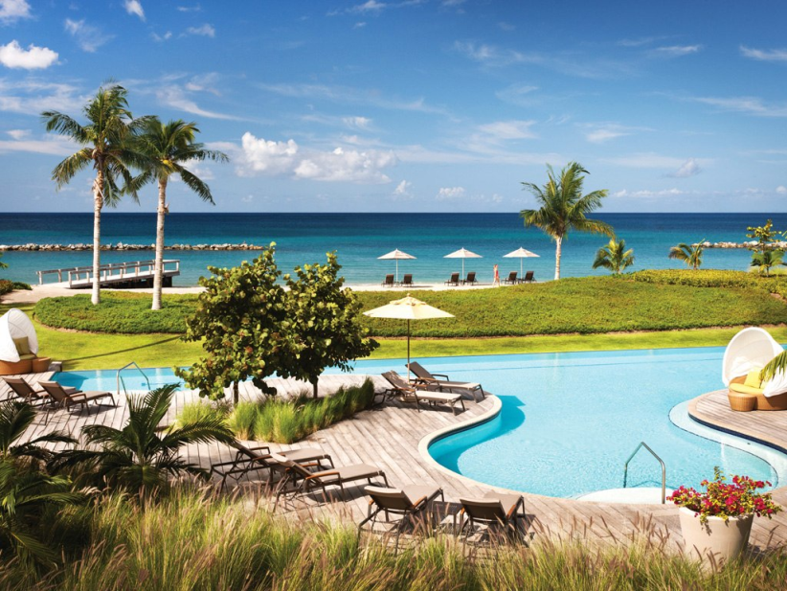
Interesting Facts
Population- 53,584 (since 2012)
Native Animals- variety of birds, bufo marinus, caretta caretta, anolis schwartzi
Most drive by car but there are buses and trains
Travel tips- dress conservatively, buses, taxis, and fairies are available for transportation, pack lightly for warm weathers

Slide 10
CONCLUSION
Saint Kitts and Nevis is a beautiful country in Central America. It has a very tropical and Caribbean vibe. St. Kitts is one of the more developed countries of North and South America with a very rich history and environment.

Slide 11
QUESTIONS
What year did St. Kitts and Nevis come into existence?
What is the official language spoken here?
Capital of the country?
What is the population?

Slide 12
BIBLIOGRAPHY
https://www.cia.gov/library/publications/the-world-factbook/geos/sc.html
www.google.com
http://stkitts-guide.info/weather/rain/
http://www.paho.org/saludenlasamericas/index.php?gid=145&option=com_docman&task=doc_view
www.wikipedia.com

