Slide 1
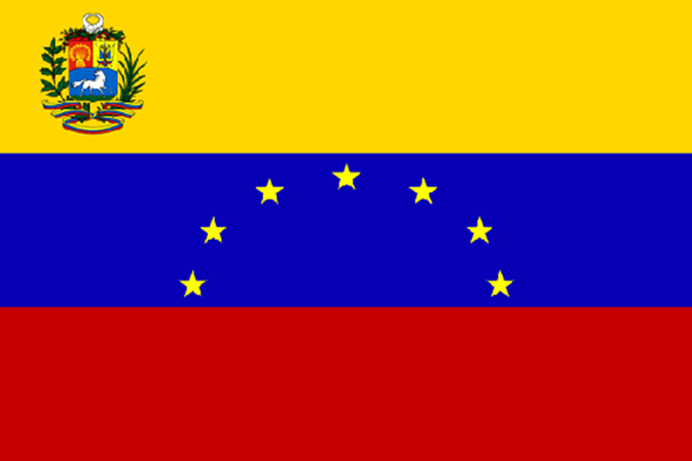
Venezuela
Abby Yarini
7th Period
3/19/14

Slide 2
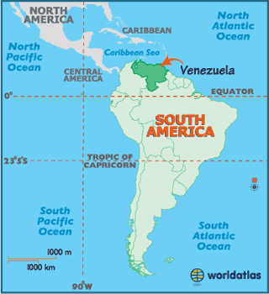
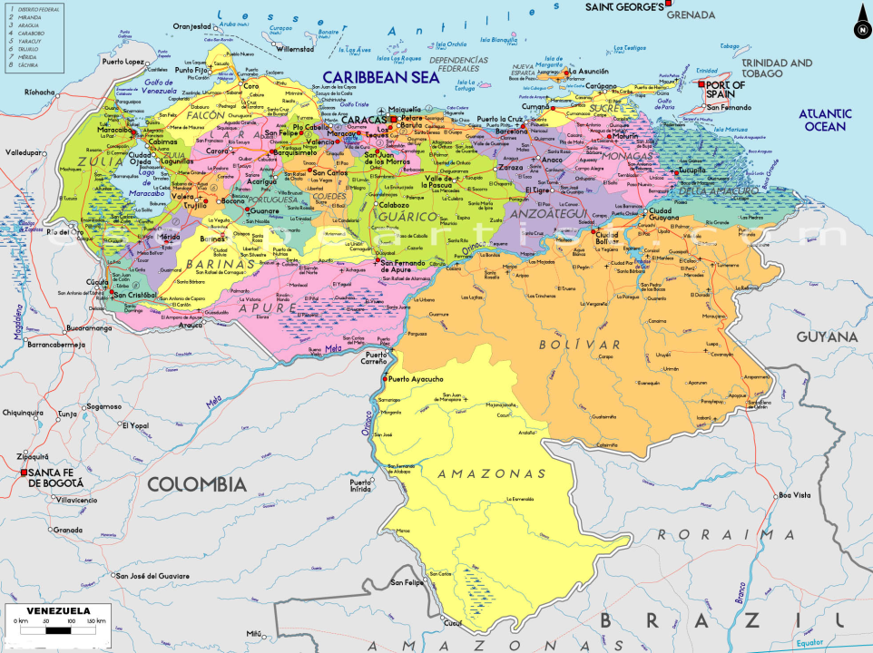
Venezuela
Capital: Caracas
Languages: Spanish (official) indigenous languages also.
Located in the very north of South America

Slide 3
History
Venezuela became a country on July 5, 1811.
Venezuela was originally ruled by mostly military strongmen, who promoted oil industry and allowed some social reforms.
Marcos Perez Jimenez became dictador in 1950.
Hugo Chavez was president from 1999 until 2013.
Chavez promoted his “"21st Century Socialism," which claimed to lessen social problems, while at the same time being against capitalist globalization and existing democratic foundations.

Slide 4
Major Events
Christopher Columbus landed in Venezuela in 1492.
Venezuela declared its independence from Spain on July 5, 1811, becoming its own country.
Spain recognizes Venezuela's independence after Simon Bolivar wins a major victory against Spanish troops at Carabobo in 1821.
Venezuela adopted its current constitution in 1999.

Slide 5
Independence
Venezuela declared independence on April 19,1810.
Ferdinand VII was the heir to the Spanish crown, but he was a prisoner of Napoleon of France.
Venezuela was finally granted independence in July of 1811.

Slide 6
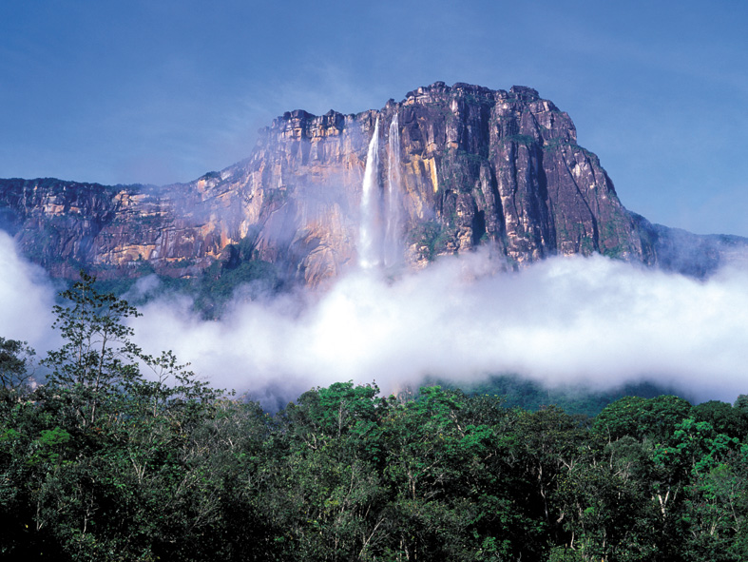
Geography of Venezuela
One major landform is Angel Falls in southern Venezuela. The water falls 3,212 feet from a tepui.
This makes Angel Falls the highest waterfall in the world.

Slide 7
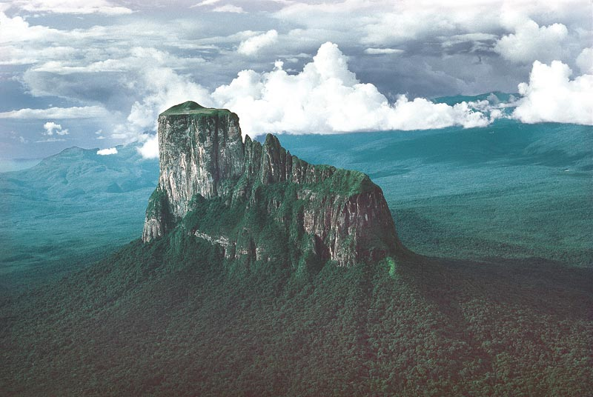
Geography Continued..
The Guiana Highlands rise in southern Venezuela, and continue through northern Brazil and Guyana, Suriname, and French Guiana. Erosion in this area has caused tepuis, such as the one that creates Angel Falls.

Slide 8
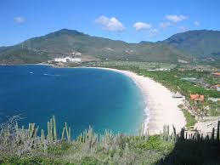
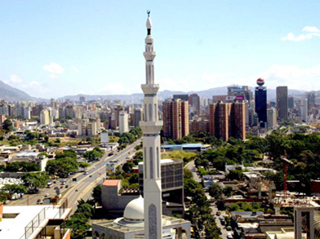
Landmarks
The beaches of Venezuela are known for their bright blue waters.
Venezuela is also known for its big cities near mountains.

Slide 9
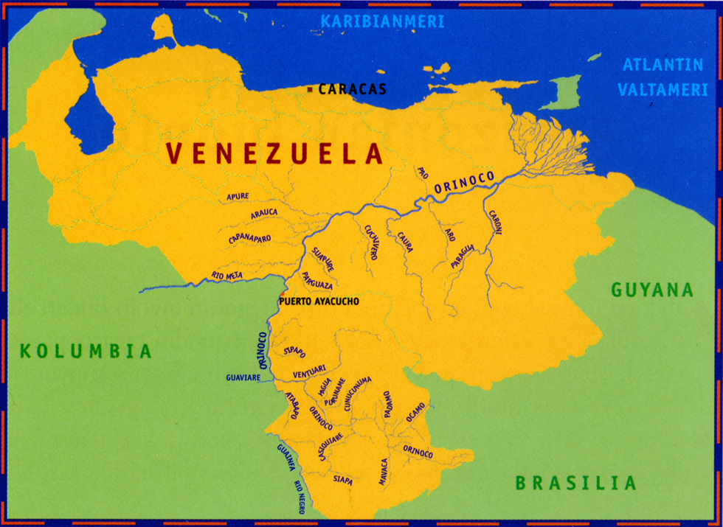
Bodies of Water
The Caribbean Sea is located north of Venezuela.
The Orinoco is a major river in Venezuela. This river also leads to several smaller rivers all over Venezuela.

Slide 10
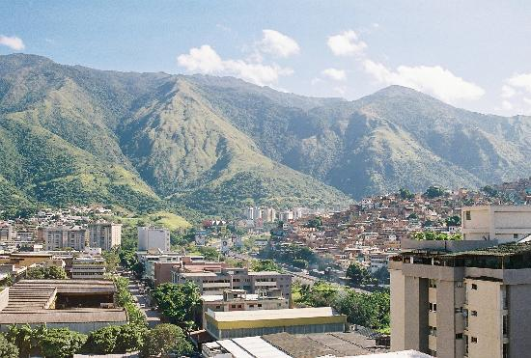
Major Cities
Caracas is the biggest city in Venezuela, and it is also the capital. It is located at the bottom of mountains in northern Venezuela.

Slide 11
Culture
A major celebration in Venezuela is Corpus Christi. This holiday is celebrated by people dressed as ‘devils’ and dancing around the streets of Venezuela. It is a Christian observance that honors the Holy Eucharist. 92% of Venezuela is Roman Catholic, while about 8% is Protestant. Venezuelan food is influenced by European countries such as Italy, Spain, and France. Clothing in Venezuela is much like the clothes worn in the US, but traditional clothing includes long frilly skirts for women. Music in Venezuela is like that of the Caribbean, such as salsa and merengue. Venezuela is a Federal Republic.

Slide 12
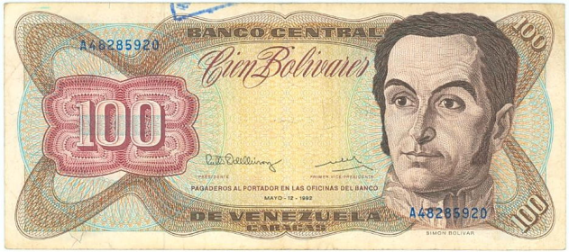
Economy
Natural resources of Venezuela include minerals. Petroleum and natural gas are the most significant resources and contribute to about one fifth of Venezuela’s GDP. Electronics and automobiles add to manufacturing areas. Most of the land in Venezuela is taken by forest. Jobs in Venezuela include jobs in services such as health cares, industrial services, education, and transportation. Also jobs in the oil industry are common. The currency is the Venezuelan bolivar.

Slide 13
Climate
The climate of Venezuela is tropical. It is hot and humid, but more moderate in the highlands.
The average rainfall of the Venezuelan highlands is 1500mm per year.
The average yearly temperature is 76.4 ̊ F.
The climate affects Venezuela because the weather makes it easy for Venezuela to produce all of its needs. Also, it affects the people and traditions of Venezuela as well.

Slide 14
Other Facts
The current population of Venezuela is 29.95 million.
The yellow of the Venezuelan flag represents new opportunities, the red symbolizes Spain, and the blue stands for the Atlantic ocean which separates the two countries. The seven stars represent the seven providences that existed during Venezuelan independence.
There is currently a security warning in Venezuela due to recent violence and crimes. In addition, 21,692 homicides in 2012 in Venezuela.
Venezuela has many airports and riding buses is also common. Cars are also a mode of transportation in Venezuela.

Slide 15
Facts continued
A new bill in Venezuela is planned to ban the ability to name children odd names.
Because Venezuela has many rainforests, animals such as tapirs, anteaters, anacondas, monkeys, and 30 different kinds of eagles are common.

Slide 16
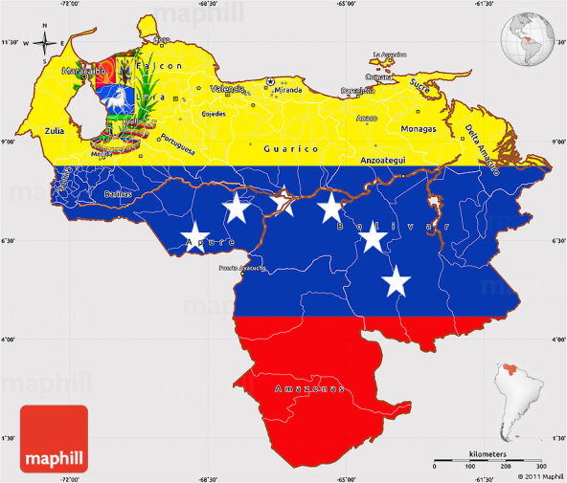
Conclusion
All in all, Venezuela is a very unique and interesting country. Venezuela has remarkable geography and land forms that are unlike any other country. The culture is diverse, with celebrations special to the country. Venezuela is a distinct and exceptional country.

Slide 17
Questions
What is the climate in Venezuela?
What is one major landform in Venezuela?
What is the Venezuelan currency?
What is a holiday celebrated in Venezuela?

Slide 18
Citations
www.worldatlas.com
https://www.cia.gov/library/publications/the-world-factbook/geos/ve.html
http://www.huffingtonpost.com/2013/05/31/venezuela-corpus-cristi_n_3366651.html
http://www.mapsofworld.com/venezuela/culture/
http://venezuelanalysis.com/image?page=3

